Slide 2



Embrace Office 365 Groups: What's New and What's Next
#BRK2056
Venkat Ayyadevara
Principal Group Program Manager
venkat.ayyadevara@microsoft.com | @vrayyadevara
Office 365 Groups
Mike McLean
Principal Program Manager
mmclean@Microsoft.com | @ @mikemcleanlive
Office 365 Groups

Slide 3
Agenda
Office 365 Groups
Membership Service
End User
Innovation
Admin
Innovation
Roadmap
#BRK2056

Slide 4

Office 365 Groups Membership Service

Slide 5


Streamline the creation and use of collaboration features
Enable communications in a secure and controlled manner
Office 365 Groups
Powering Collaboration Across Microsoft 365
Share knowledge and information using email, calendaring, documents and more
Leverage self-service capabilities to reduce costs and save time

Slide 6

Groups by the numbers…
107%
Annual increase in usage across Groups platform
1,000
Distribution Lists upgraded to Office 365 Groups each week
8X
Reduction in group creation latency
9M
Guests provisioned through Office 365 Groups
21→2hrs
Improved in response time using Actionable Emails
60%
Groups renewal during Expiry Autorenewal Private Preview

Slide 7

























Powering Collaboration Across Microsoft 365
Membership service for Microsoft 365 teamwork apps
22+ Apps
Easy to share with your team
Partner ecosystem
Office 365 Groups
Centrally managed, secured, and governed
Azure Active Directory
Notes:
Groups are reused across 22 services: Calendar, Delve, Dynamics 365, Excel, Flow, Forms,
OneDrive for Business, OneNote, Outlook, People, Planner, Power BI, PowerApps, PowerPoint,
SharePoint Online, StaffHub, Stream, Sway, Microsoft Teams, Office 365 Video, Word and Yammer.

Slide 8


Eliminate the Need for Shadow IT
“…shadow IT is always a case of people trying to get their job done better/easier and usually occurs when they can’t get IT to support them effectively.”
- CIO.com
Creation permissions
Soft delete and restore
Policies and information protection
Naming policy
Expiration policy
Guest access
Reporting
Tools
Notes:
https://www.cio.com/article/3314738/shadow-it-the-cio-s-perspective.html
CIOs believe that embracing shadow IT is how IT departments go from the department of “no” to the department of “know.”
https://www.informationweek.com/strategic-cio/it-strategy/make-shadow-it-a-force-for-good/a/d-id/1332595
https://www.gartner.com/smarterwithgartner/make-the-best-of-shadow-it/

Slide 9

End User Innovation

Slide 10
End User Innovation
Demo

Slide 11
End User Innovation
Last 12 Months Highlights
Member Management
Teamwork
Employee Engagement
Groups hub pending membership
Search for Group Members on the Group Card
Actionable emails for member approval on web/mobile
Microsoft Teams mobile member management
Multi-team support for FirstLine
Planner link to Groups Hub
Use Outlook Desktop to drag and drop emails to a Group Mailbox (move or copy)
Calendar entries can be owned by a Group Calendar and include selected invitees
Support for Group Calendar on iOS
Teams channel moderation
Receive personal copies of email sent to a Group Mailbox
SharePoint as a default files storage location
Deeper integration for Live Events leveraging Microsoft Stream
Create announcements in Teams channels
Notes:
Support for Question and Answer, rich text, and a new and improved user experience for Communities.

Slide 12

Admin Innovation

Slide 13
Admin Innovation
Demo

Slide 14
Admin Innovation
Last 12 Months Highlights
New Management Capabilities
Improved Admin Experiences
Managing at Scale
Naming policy generally available
Provide expiry notifications in the context of the app
Assign the Groups Administrator role to manage groups across the organization
Rename the SharePoint Site URL associated with an Office 365 Group
Improved Group management in Microsoft Admin Center
Browse and restore deleted groups
Quickly view which groups are enabled for Microsoft Teams
Modify properties as Global Admin without Exchange License assigned
Advanced filtering and sorting capabilities
Onboard users through Entitlement Management to quickly provide access to groups and apps
Define a unified set of Microsoft Information Protection labels which drive behavior across all groups
Automatically renew expiring groups based on group activity
Microsoft Graph updates for hideFromOutlookClients and hideFromAddressLists

Slide 15
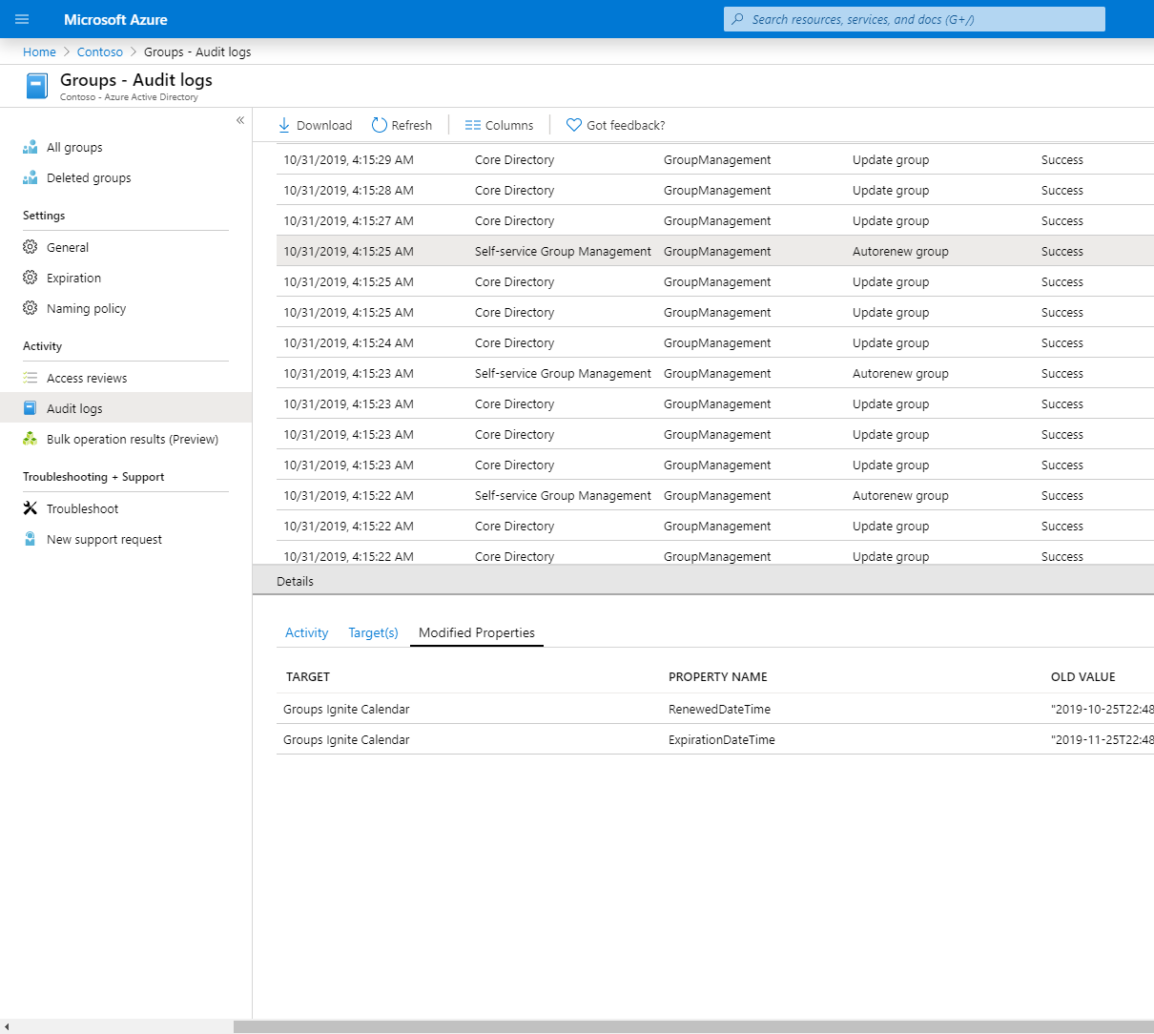
Groups Expiry Auto-renewal
User Activity based Expiration Policy is now Generally Available
SharePoint – View, Edit, Download, Move, Share, Upload
Outlook – Join group, Read/Write message from group space, Like a message in OWA
Teams – Visit a Channel in Microsoft Teams
Blog Post: User Activity based Expiration Policy for Office 365 groups is now generally available!

Slide 16
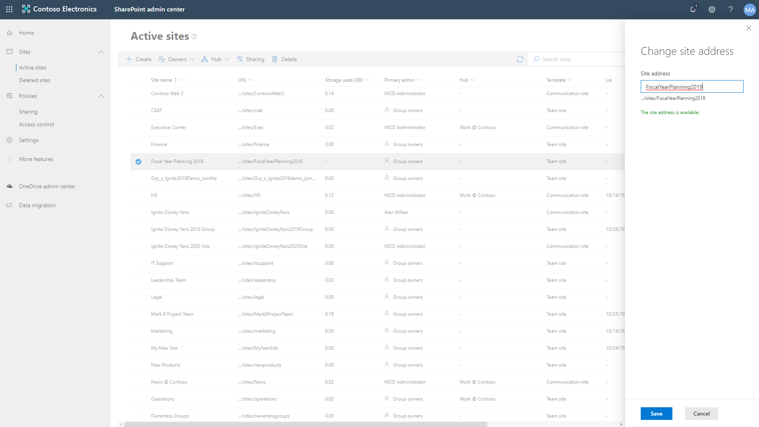
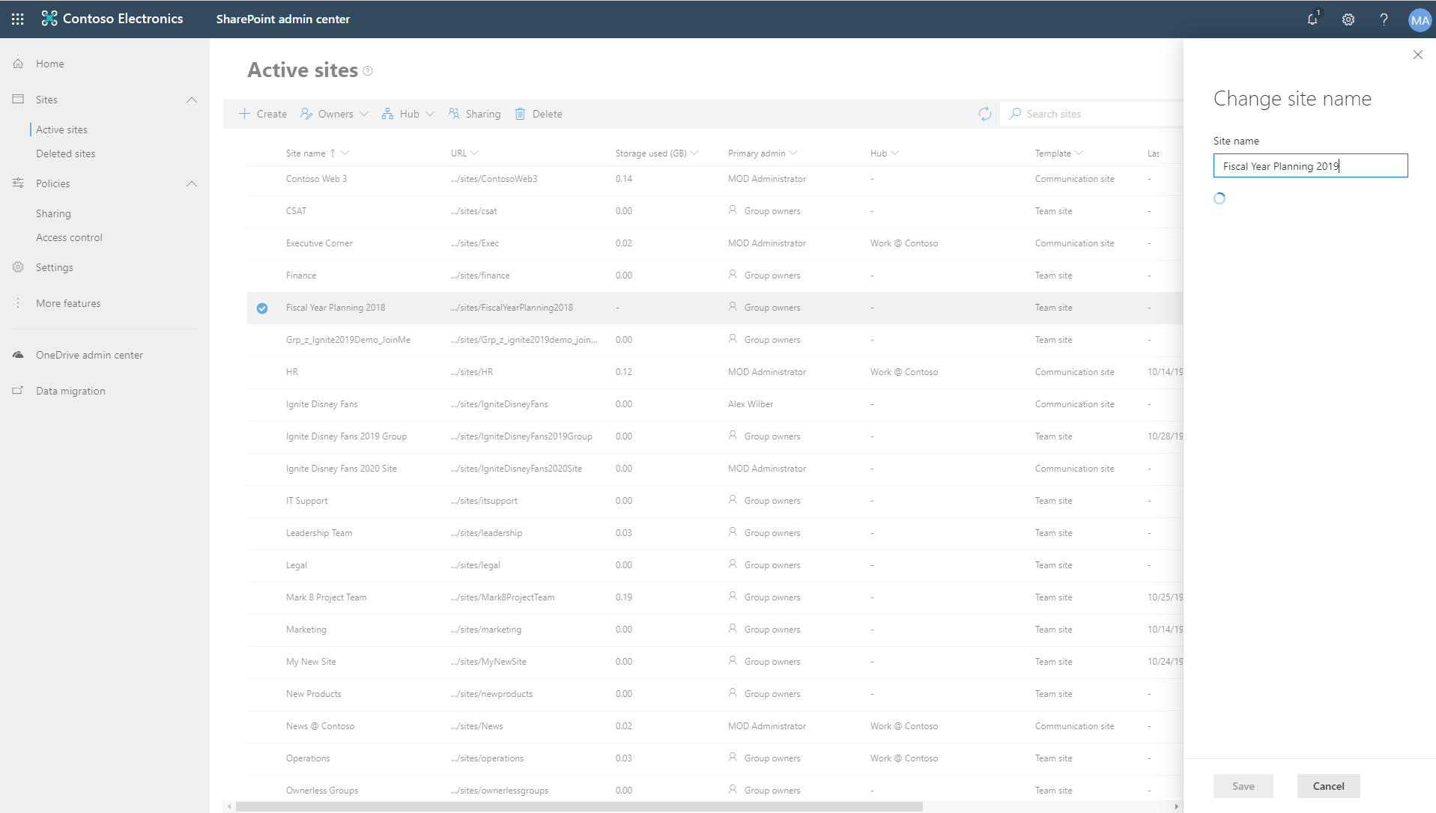
SharePoint Site URL Rename
Change the URL for Office 365 group-connected team sites, modern team sites not connected, Communication sites, and Classic team sites
Permissions, sharing links, synced locations, and recent lists in Office apps (MRU) updated
Users won't be able to view the team's files within the Teams app, but access them from Teams by selecting Open in SharePoint
Re-associate Hub Sites, InfoPath forms, and SharePoint workflow 2013, etc
Documentation: https://aka.ms/siterename

Slide 17

Roadmap

Slide 18
Office 365 Groups roadmap
from Ignite 2018
Expiry: in-app expiry notification and auto-extend based on activity
New and improved group admin roles
Admin center improvements
Unified Group classification using Microsoft Information Protection Labels
(Public Preview)
Teams: dynamic membership support, manage Teams page
Group driven membership

Slide 19

Office 365 Groups roadmap
Office 365 Groups classification using Microsoft Information Protection Labels (General Availability)
Expanded capabilities for Groups Administrator role
Additional Microsoft Admin Center enhancements
Improvements to Dynamic Groups at scale
Information Barrier support for Office 365 Groups
Native Mode for Yammer
Group driven membership

Slide 20
Office 365 Groups Sessions @ Ignite
Breakout Sessions
MONDAY: BRK2056 - Embrace Office 365 Groups: What's new and what's next (4:30 – 5:15)
TUESDAY: ADM20 - Addressing top management issues with users and groups (10:15 – 11:00)
WEDNESDAY: BRK2210 - Finding your collaboration sweet spot with Office 365 Groups, SharePoint, Teams, and Yammer (3:15 – 4:00)
THURSDAY: BRK3264 - Transform collaboration and fight shadow IT with Office 365 groups (10:15 – 11:00)
FRIDAY: BRK2058 - Deploy Office 365 groups at scale to power Microsoft Teams, Outlook, Yammer, and SharePoint (9:00 – 9:45)
Theater Sessions
TUESDAY: THR3083 - Office 365 Groups: Ask us anything (12:40 – 1:00)
WEDNESDAY: THR2091 - Master sharing and permissions of Office 365 in 20 minutes (2:30 – 2:50)
WEDNESDAY: THR3043 - Microsoft Teams and Office 365 Groups PowerShell MasterClass (3:40 – 4:00)
Related Sessions
MONDAY: THR2251 - How Microsoft empowers employees through self-service collaboration while still protecting the company in Office 365 (1:40 – 2:00)
TUESDAY: BRK2233 - The future of Yammer: Share knowledge, engage leaders, and build communities in Microsoft 365 (9:00 – 10:15)
WEDNESDAY: BRK2052 - What's new and what's next: SharePoint and OneDrive administration (12:45 – 1:30)

Slide 21

Create a governance plan https://aka.ms/GroupsGP Enable self-service https://aka.ms/GroupsSS Engage FastTrack https://microsoft.com/FastTrack Enable analytics to understand usage https://aka.ms/UsageAnalytics Connect with community https://aka.ms/M365TC Check out our blog https://aka.ms/M365TCBlog
Call to Action

Slide 22

FastTrack Your advisor to help deploy Microsoft 365
Visit our FastTrack booth
Onboard to Microsoft 365 services and migrate your data​
Configure identity and security capabilities ​
New! Guide Windows 10 deployment ​
Deliver app compat services​
Deploy chat-based collaboration and productivity apps​
Gain customer user adoption and realize business value​
Delivered by Microsoft or approved partners​
Included in your eligible subscription at no additional cost​
www.Microsoft.com/FastTrack
Notes:
Slide objective: Overview of FastTrack for Microsoft 365
FastTrack for Microsoft 365 helps organizations decrease time-to-value when deploying cloud solutions. Specifically, FastTrack can help customers:
Migrate email and content, and onboard to Microsoft 365 services. We’ll enable customers to quickly deploy new cloud capabilities with Microsoft 365, including assessment and remediation guidance to help prep their infrastructure for the cloud.
Enable identity, device management, and modern security. Deliver the value of the Microsoft 365 security and management stack to their organization.
Last year, we introduced an application compatibility service and this year, we’ve added Windows 10 deployment service to help customers move off of Windows 7 and onto Windows 10.
Deploy chat-based collaboration with Microsoft Teams and productivity apps with Office ProPlus.
Gain user adoption and realize business value.
FastTrack is an ongoing and repeatable benefit delivered by Microsoft engineers and approved partners to help customers deploy and adopt Microsoft 365 cloud services at their own pace. FastTrack is included in their eligible subscription at no additional cost.
All customers can log in to the FastTrack online portal to access planning resources and training assets with an Azure AD account. Many resources do not require a login at all.
150+: Customers with 150+ seats have access to FastTrack specialists to support their Microsoft 365 cloud deployment and adoption.
500+: For customers with 500+ seats, FastTrack will perform your data/email migration for you, freeing up time to allow you to deploy more products at one time.
And, FastTrack will integrate with partners and work together to ensure a successful project. If you don’t have a partner, we can refer you to one for additional services.

Slide 23
Thank you!
#BRK2056
Venkat Ayyadevara
Principal Group Program Manager
venkat.ayyadevara@microsoft.com | @vrayyadevara
Office 365 Groups
Mike McLean
Principal Program Manager
mmclean@Microsoft.com | @ @mikemcleanlive
Office 365 Groups

Slide 24
Appendix

Slide 25
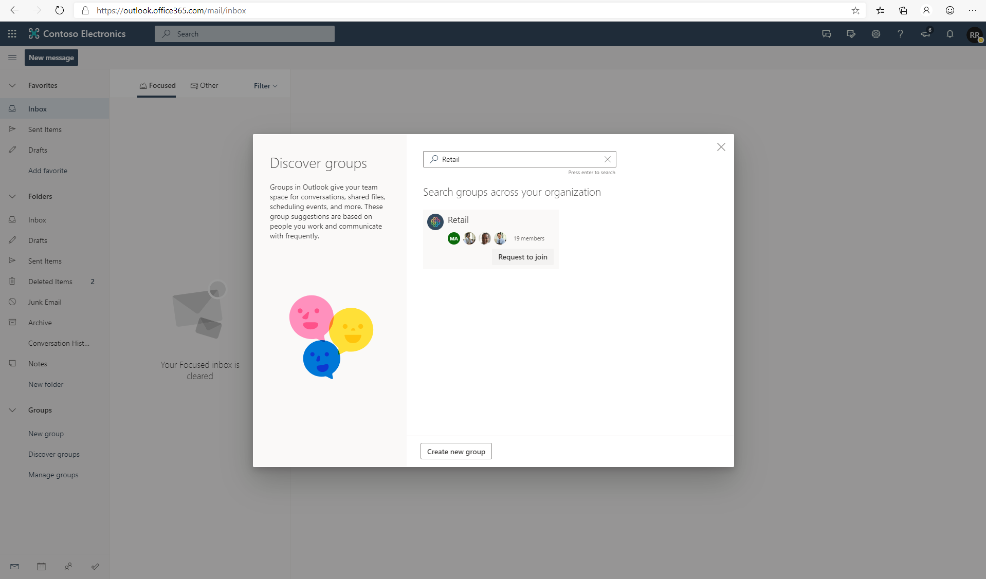

Slide 26
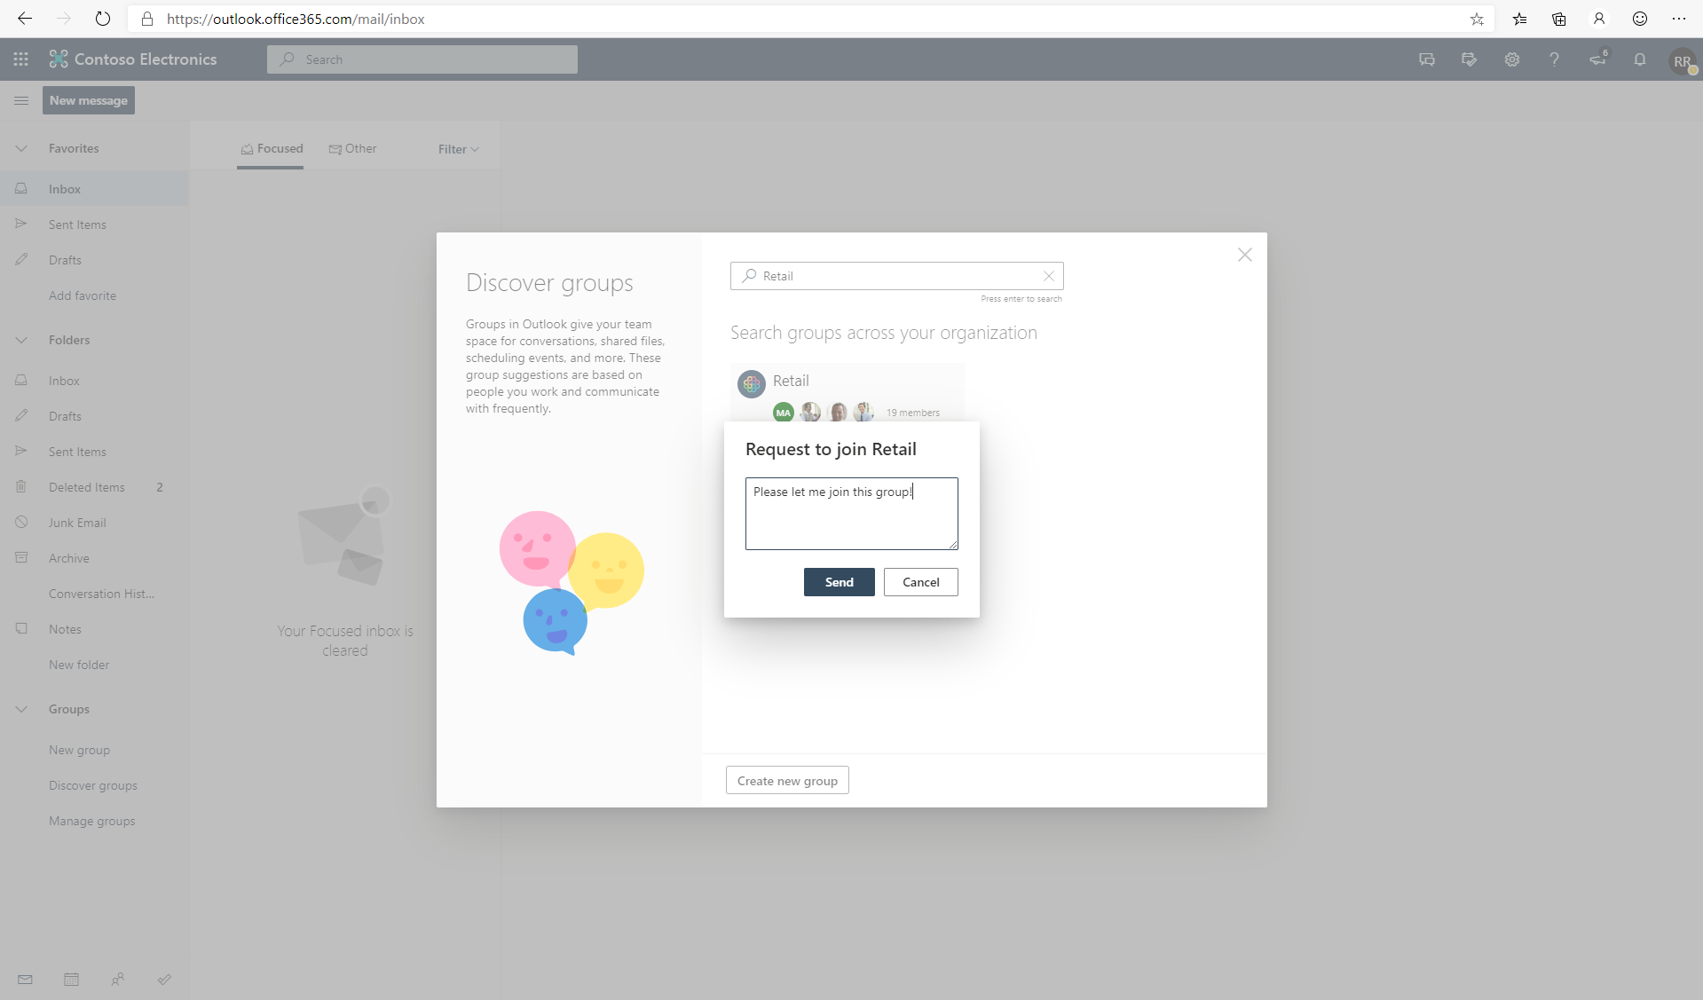

Slide 27
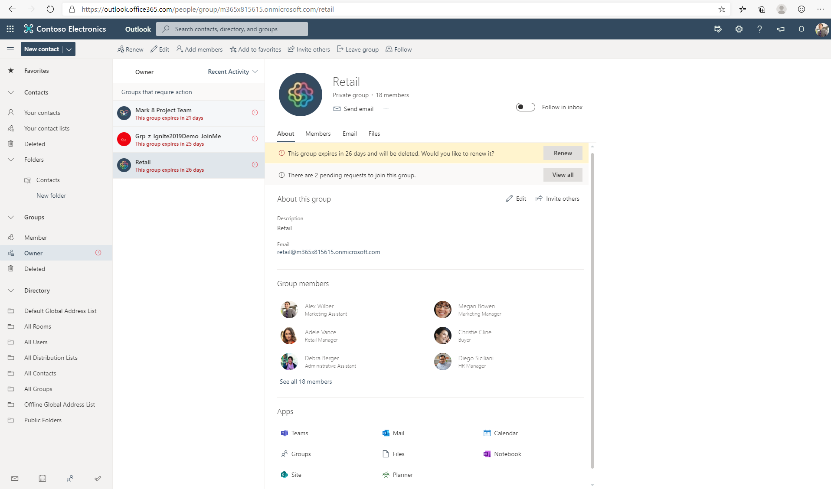

Slide 28
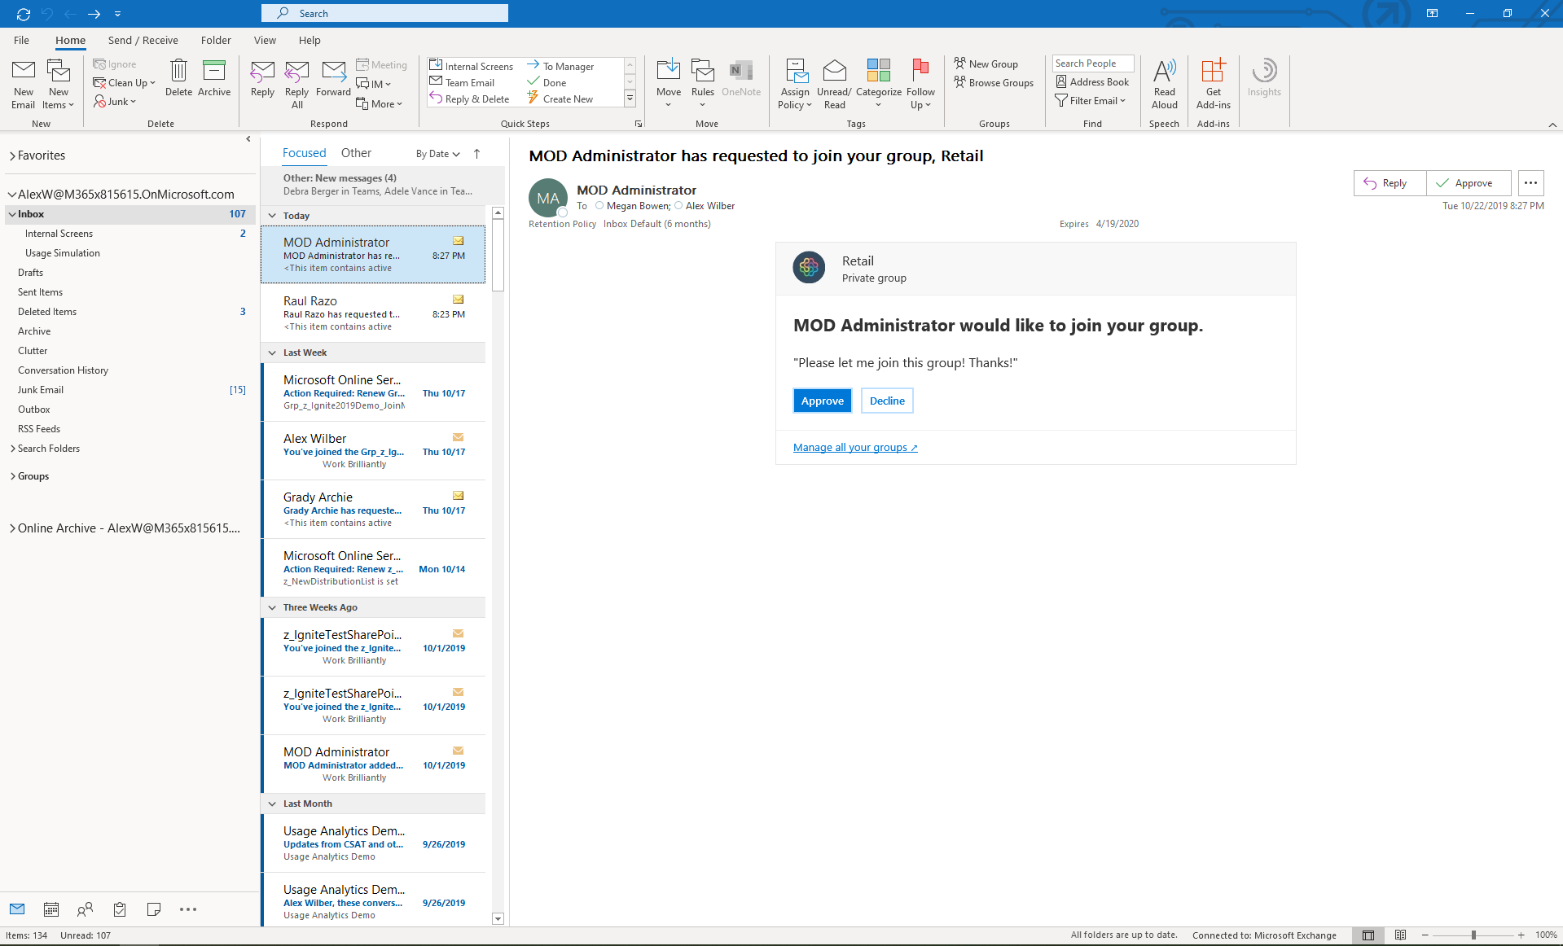

Slide 29
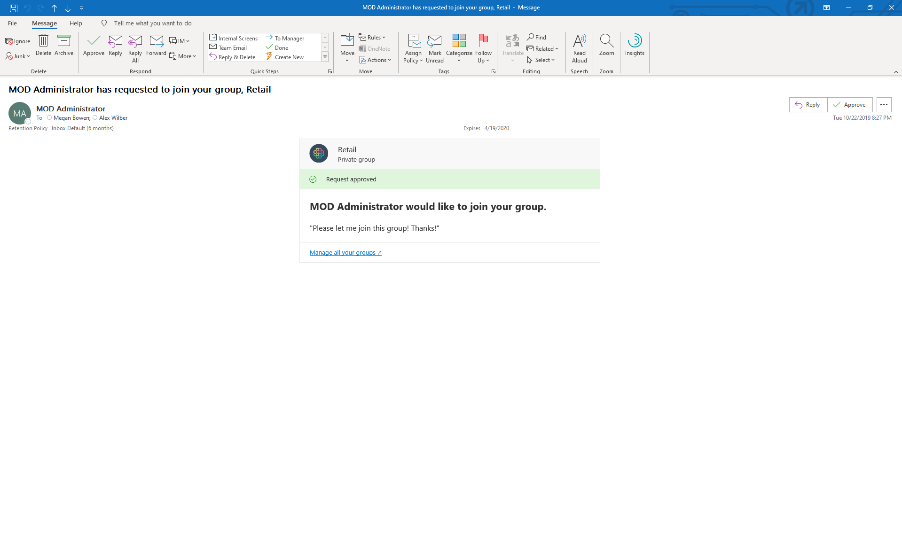

Slide 30
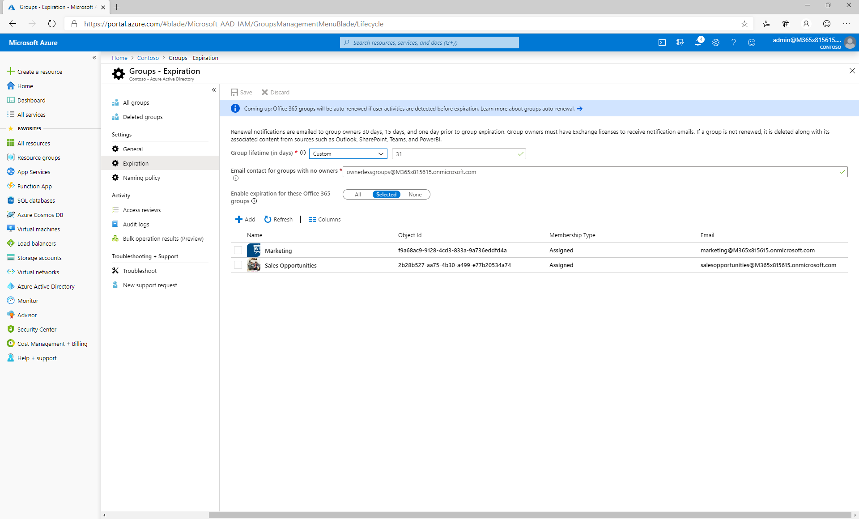

Slide 31
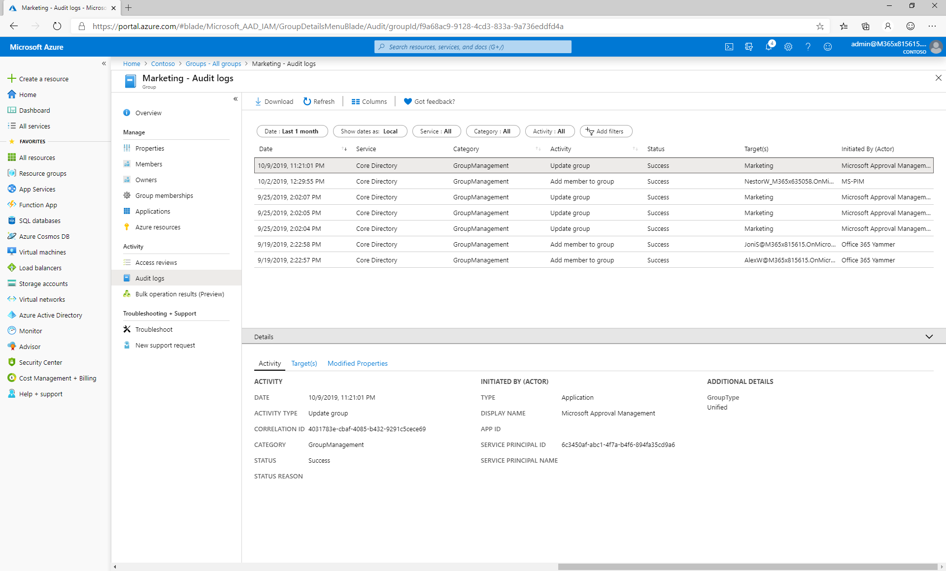

Slide 32
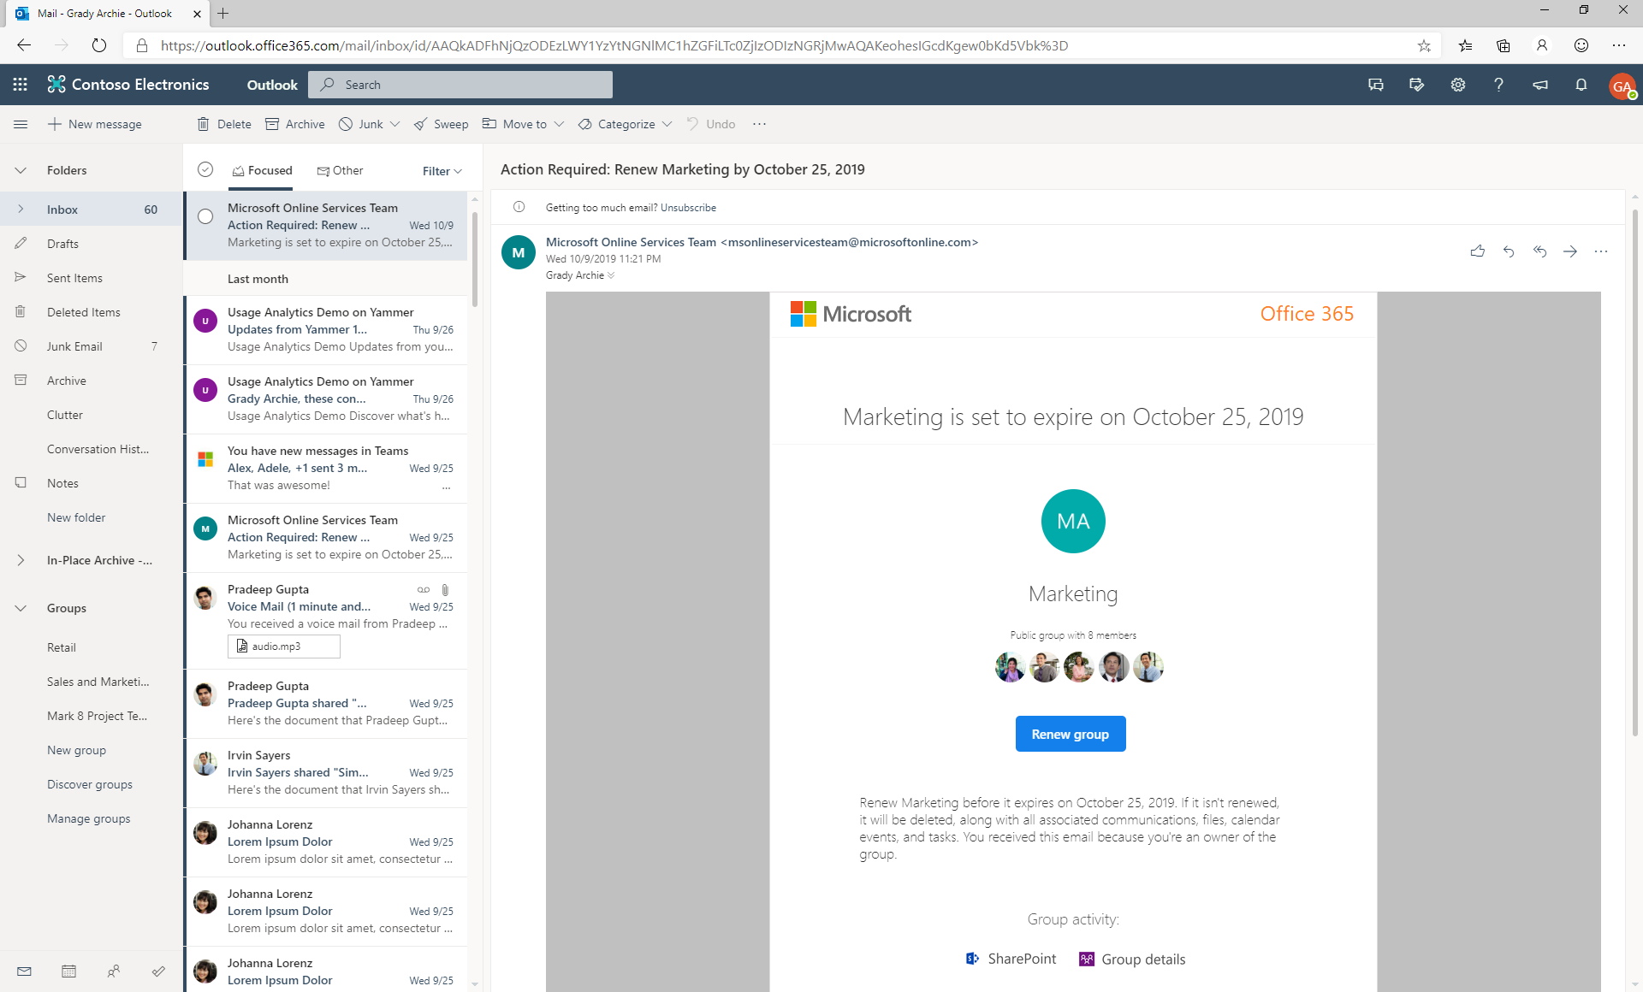

Slide 33
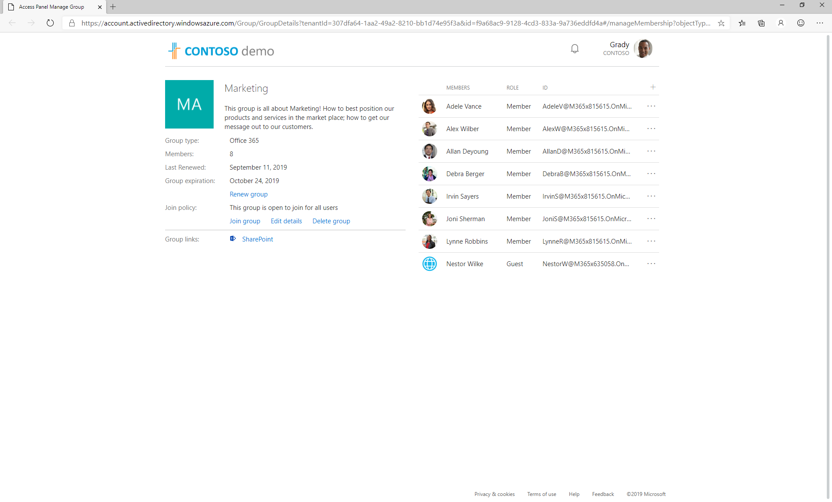

Slide 34
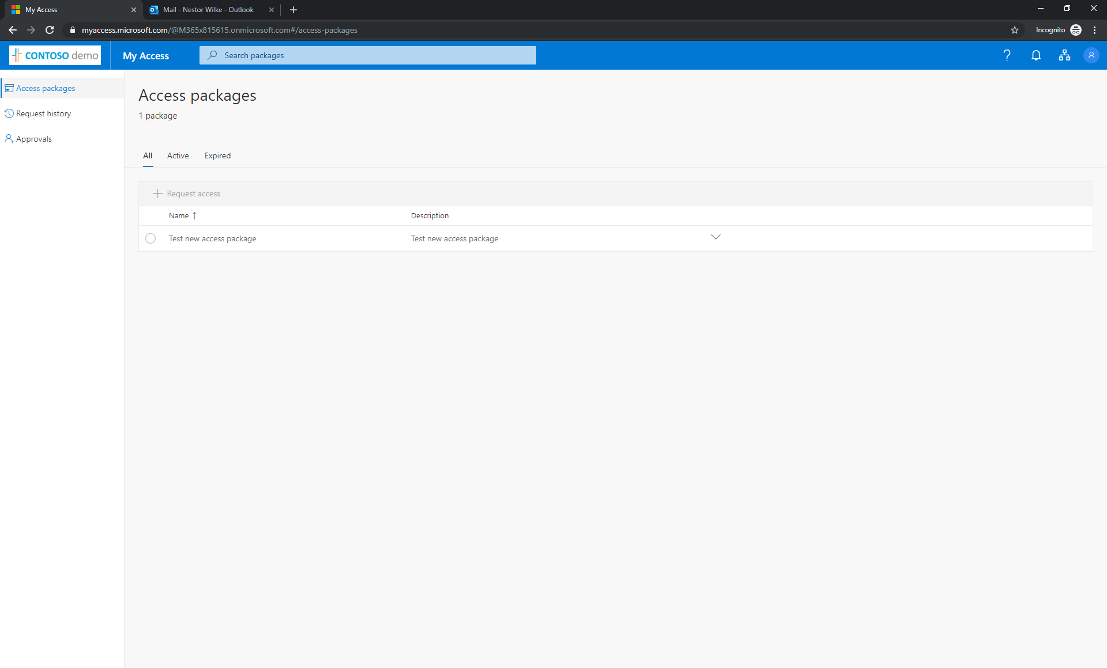

Slide 35
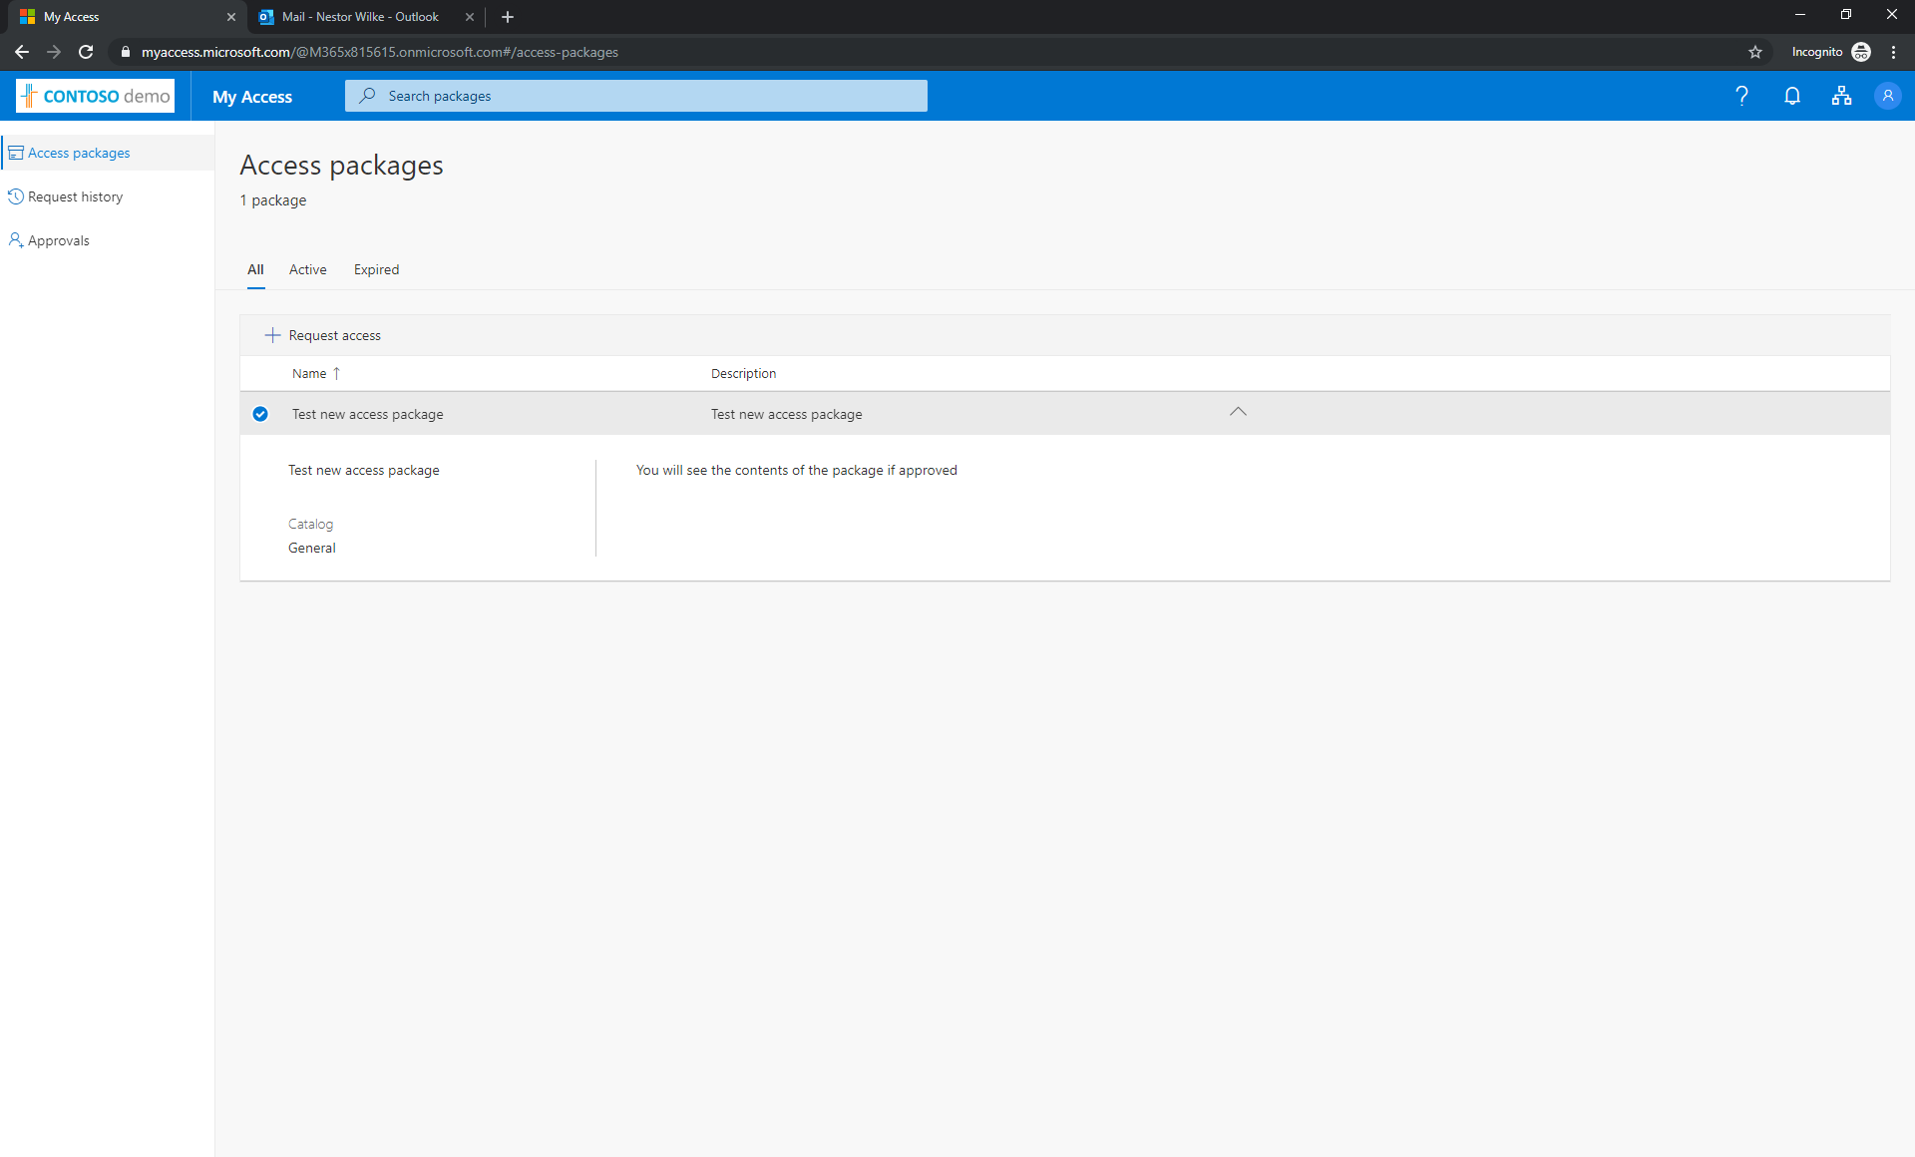

Slide 36
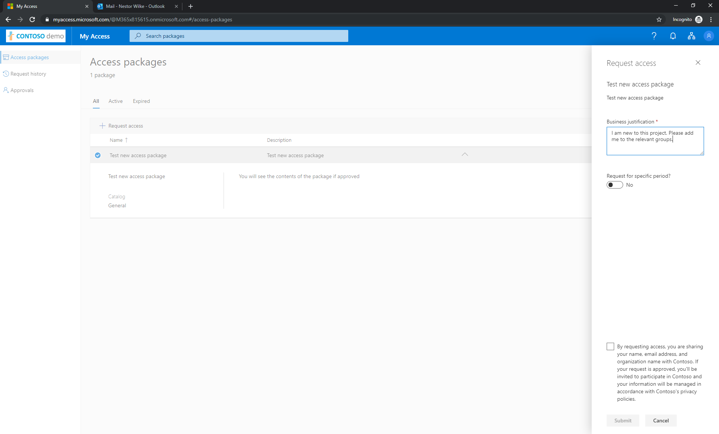

Slide 37
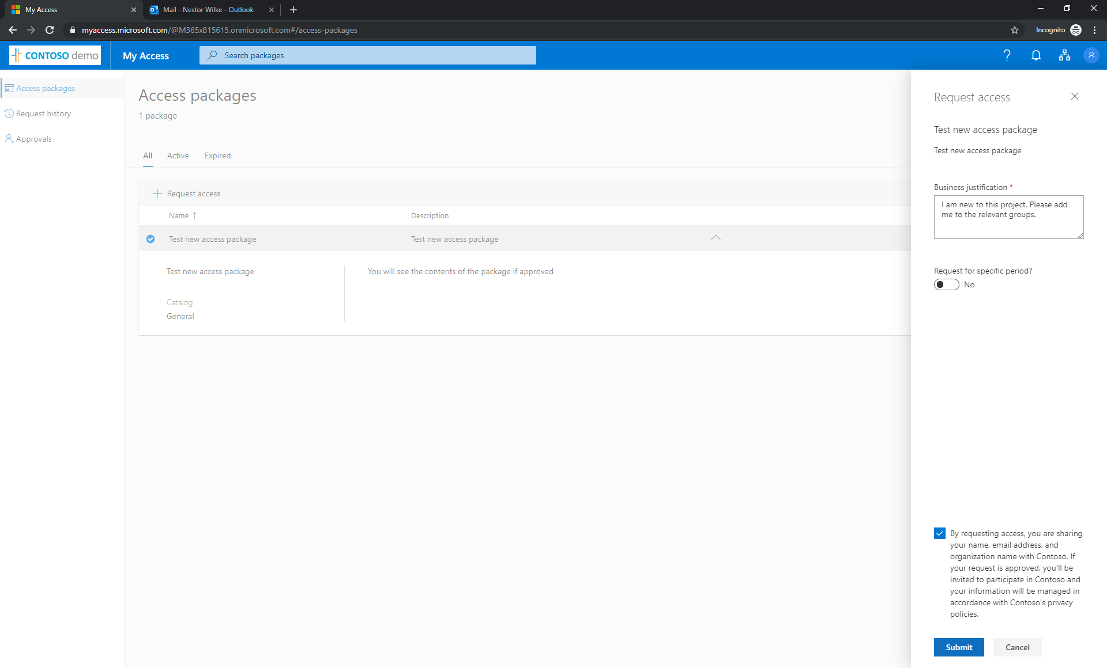

Slide 38
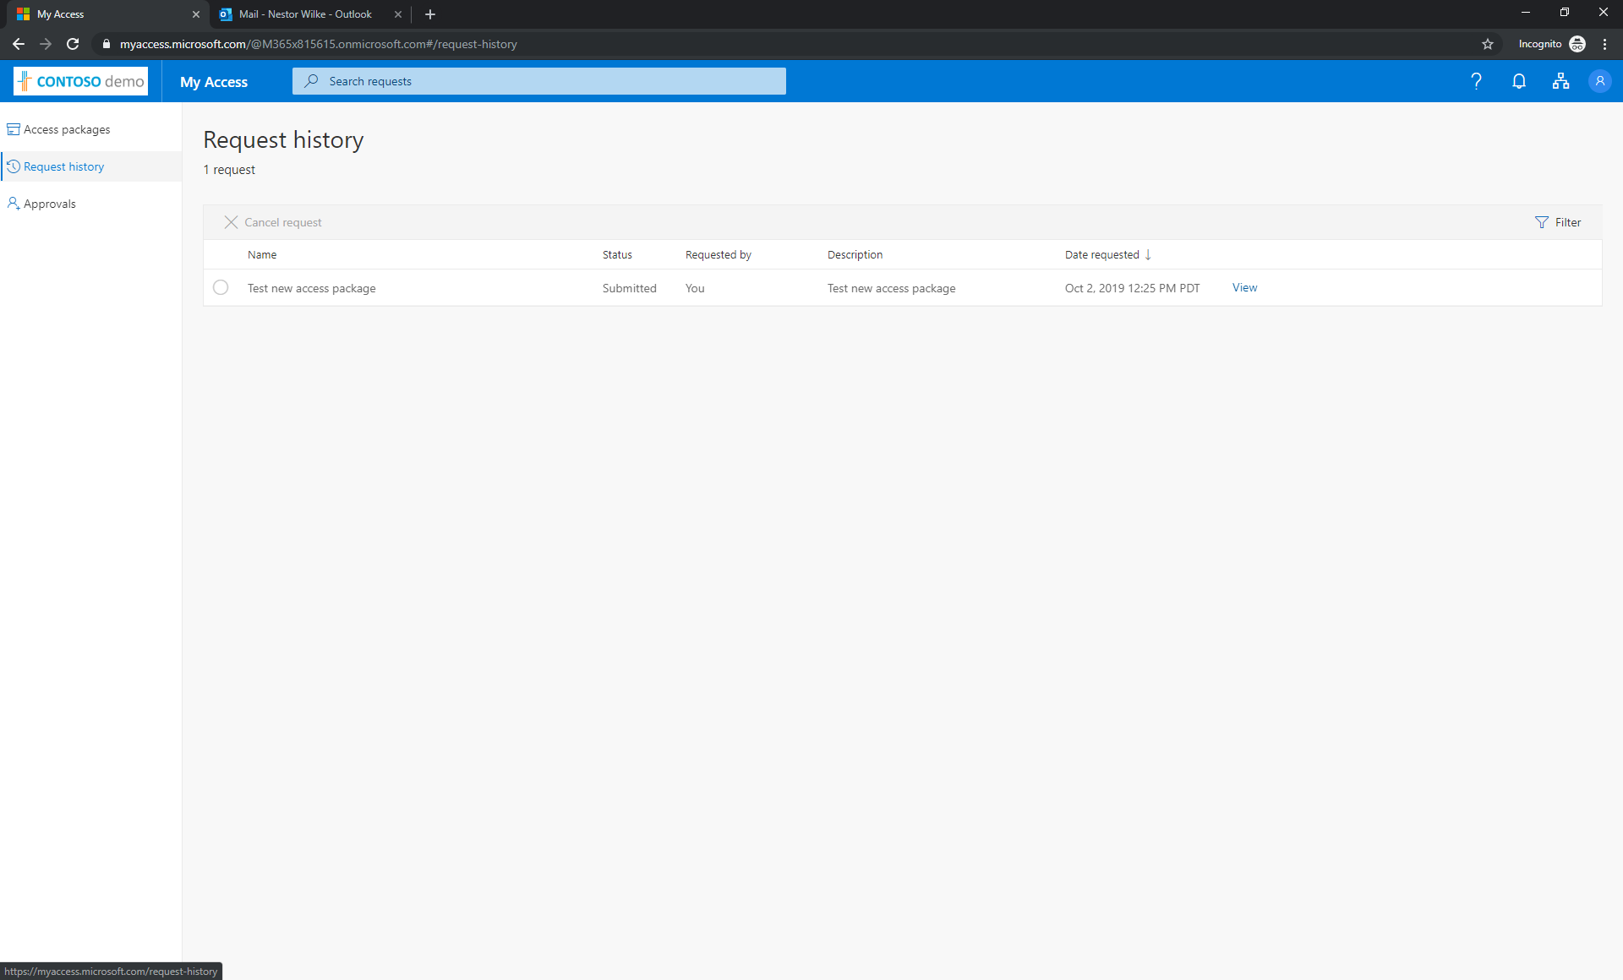

Slide 39
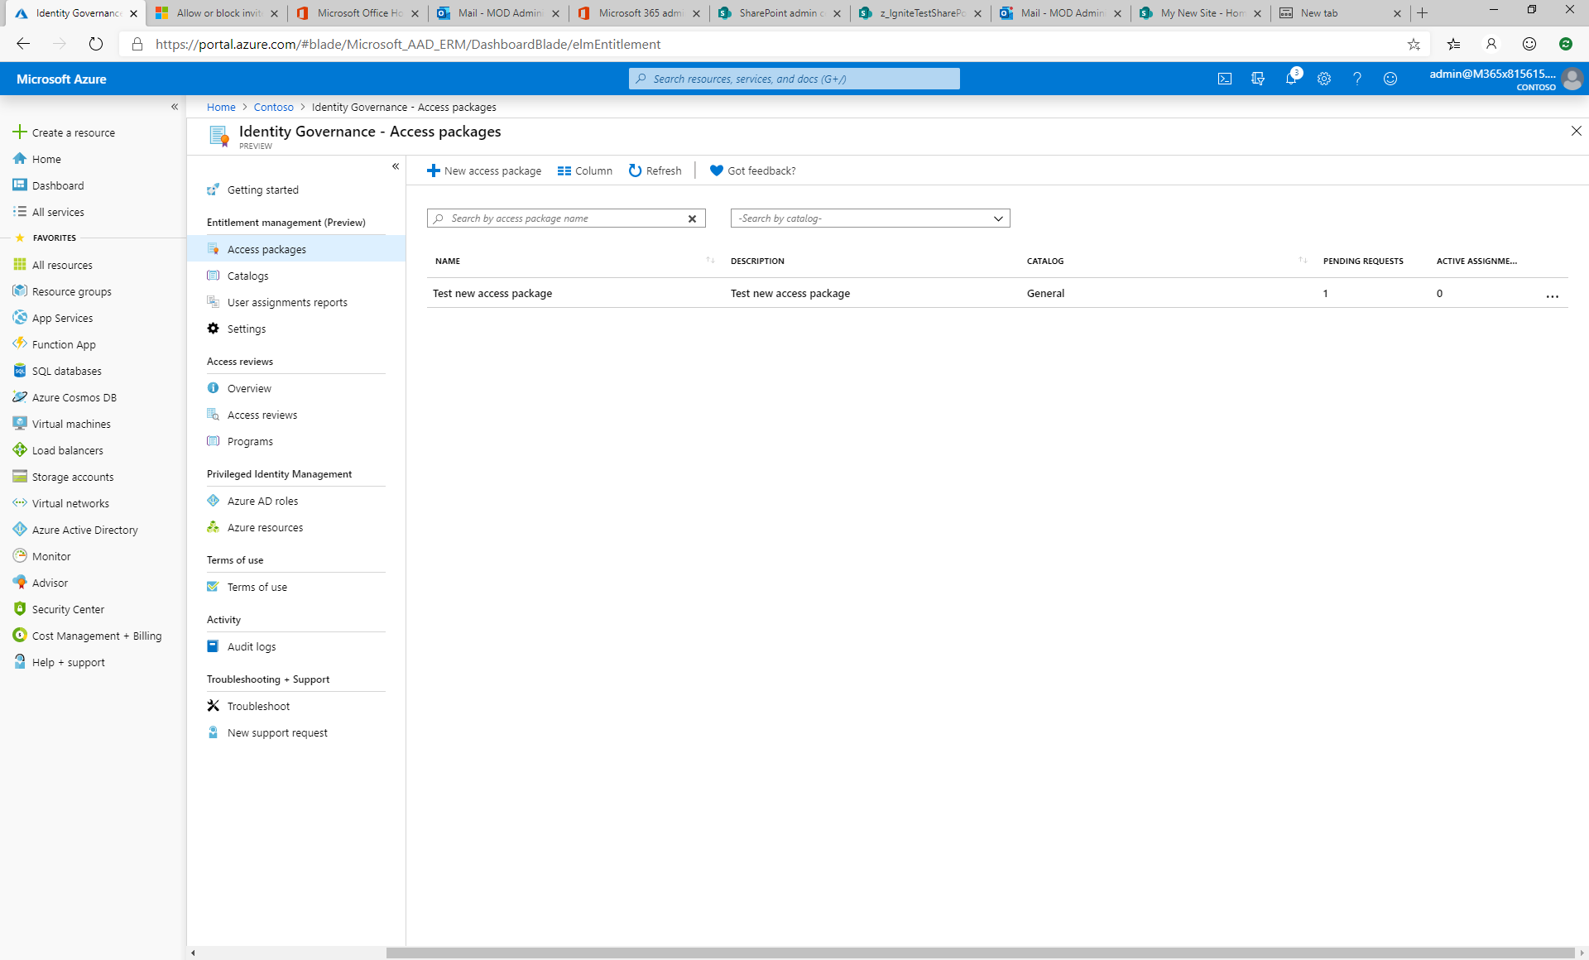

Slide 40
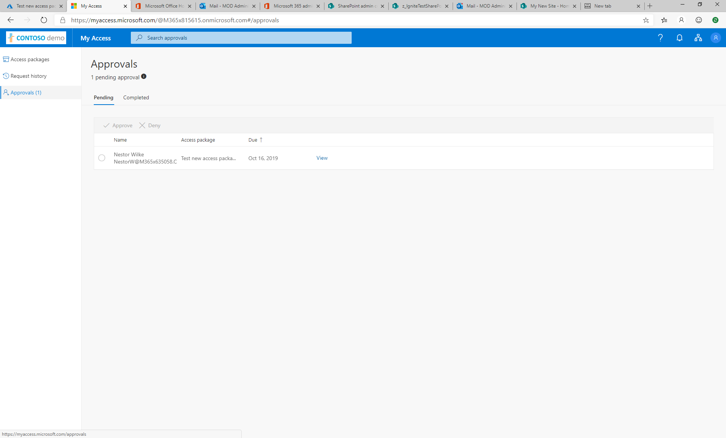

Slide 41
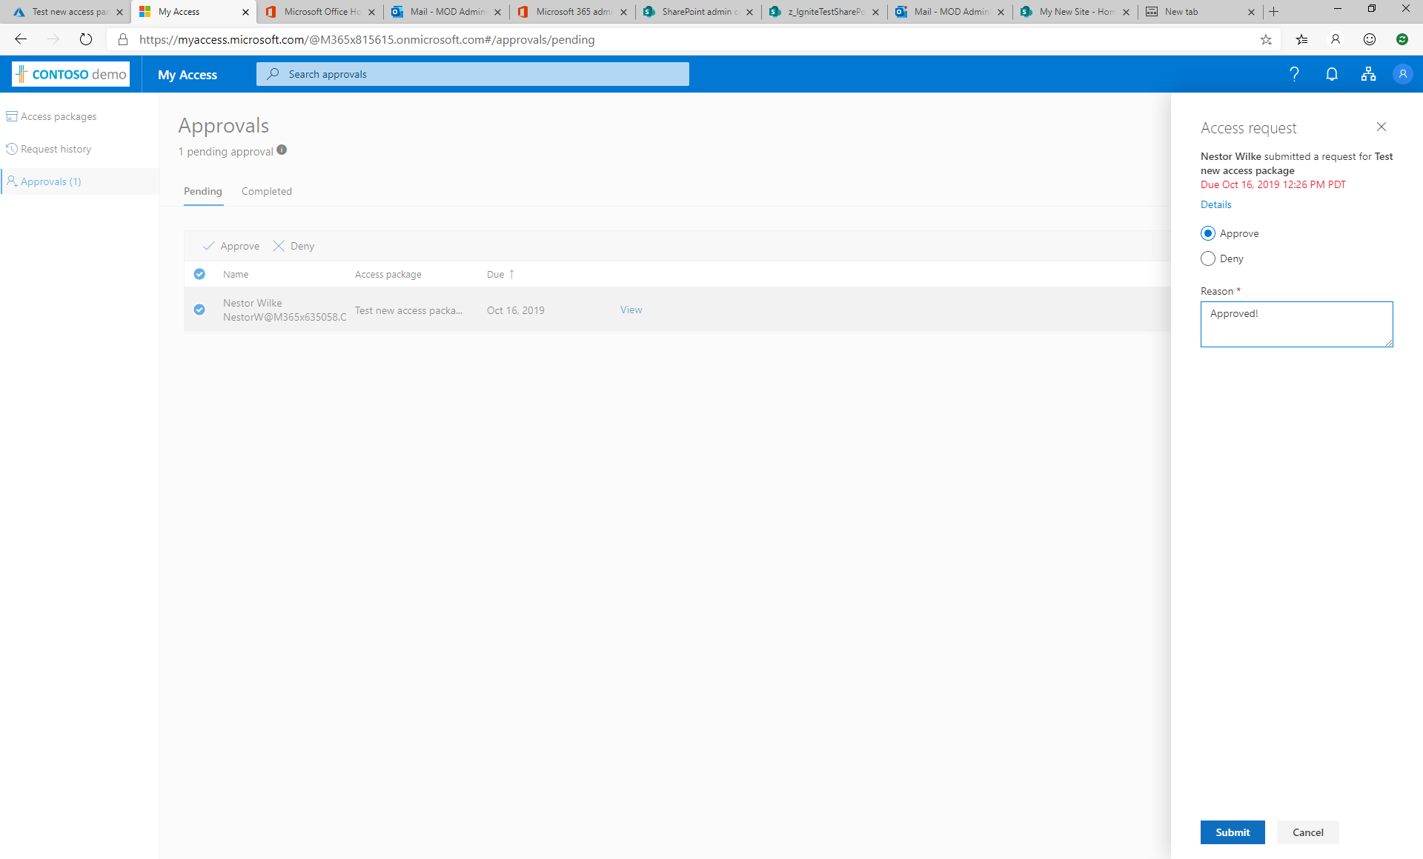

Slide 42
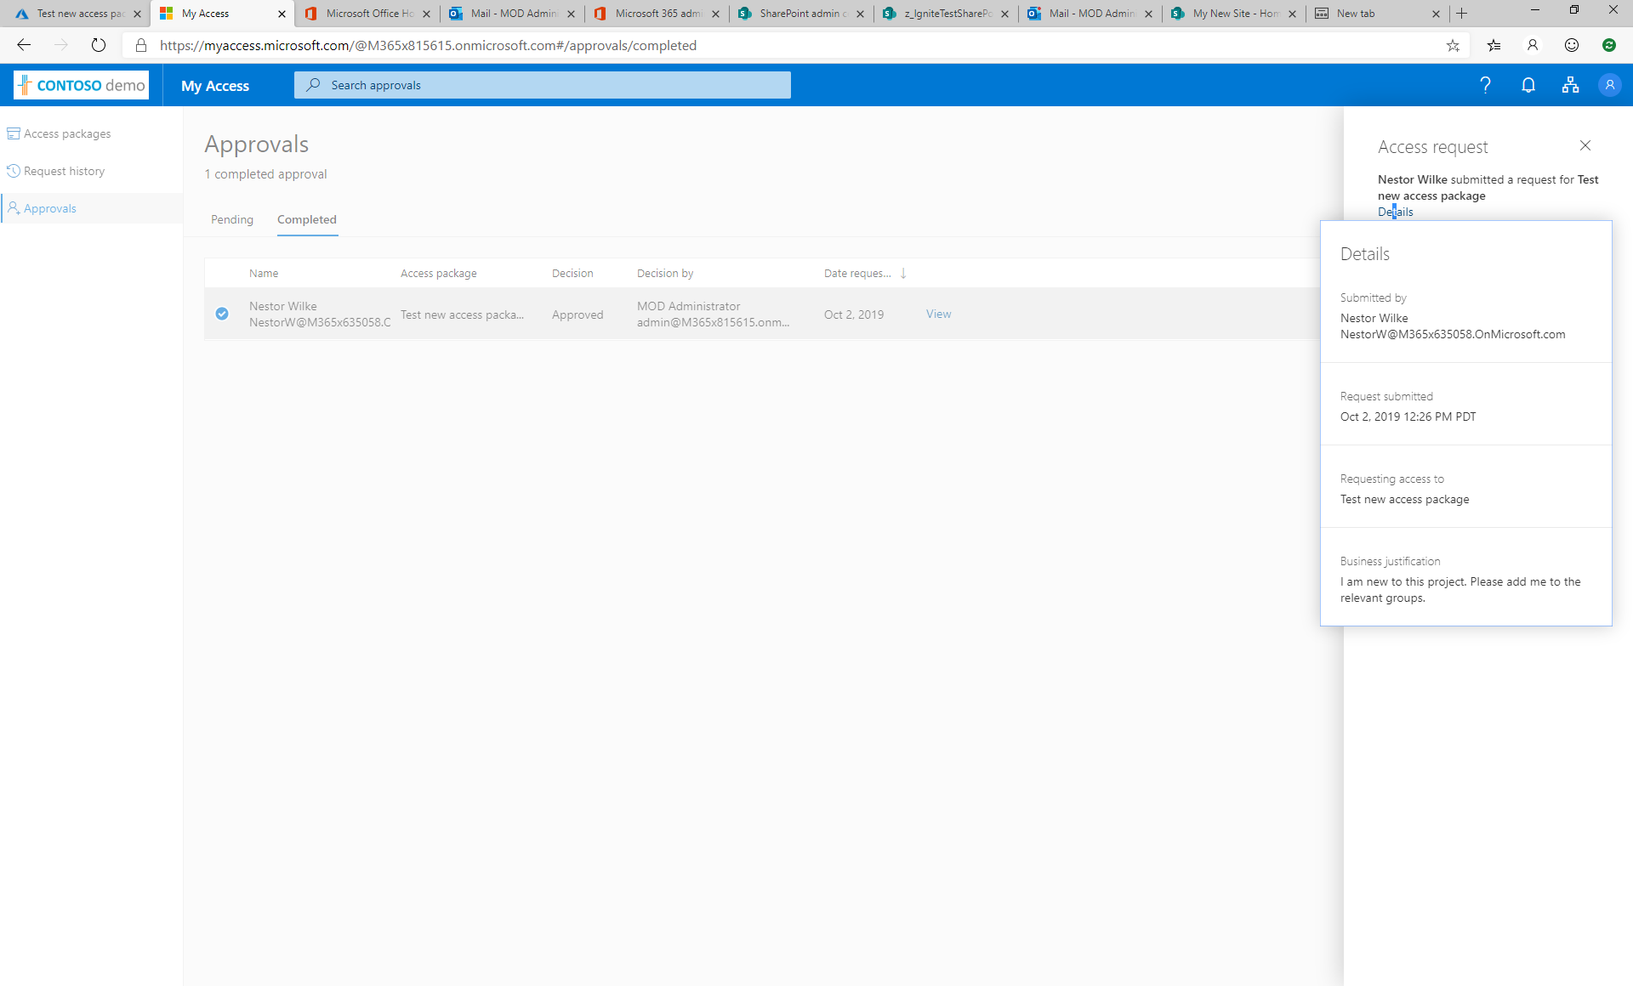

Slide 43
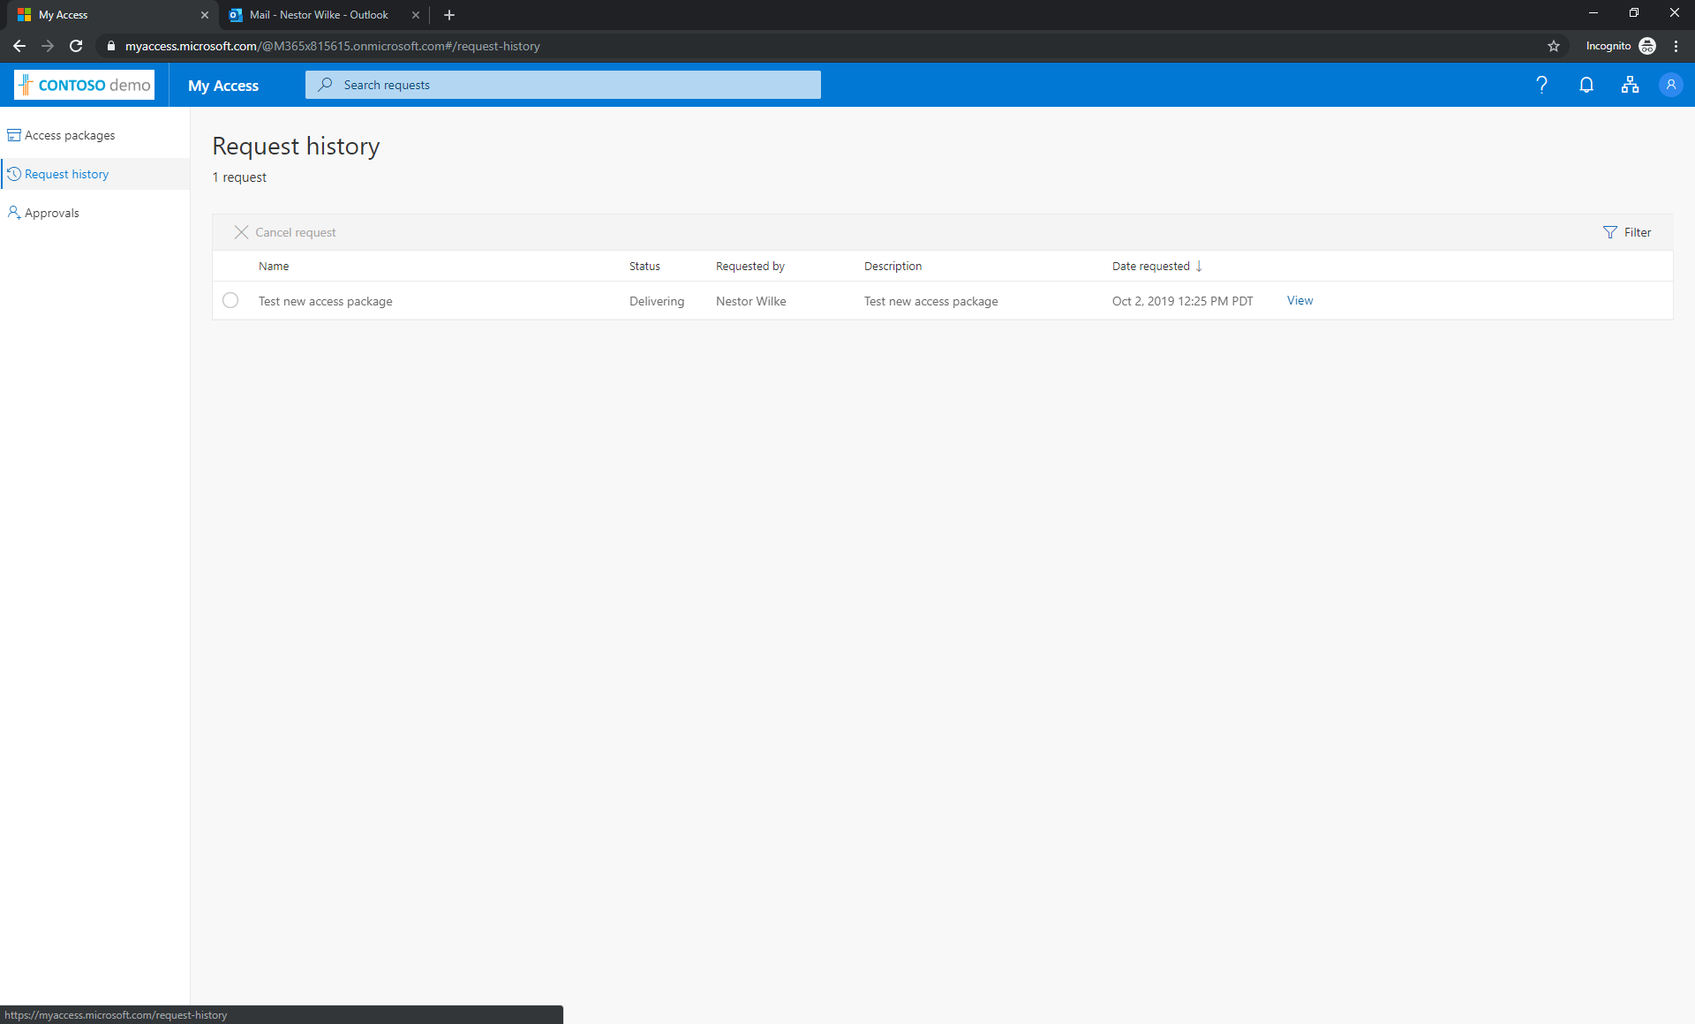

Slide 44
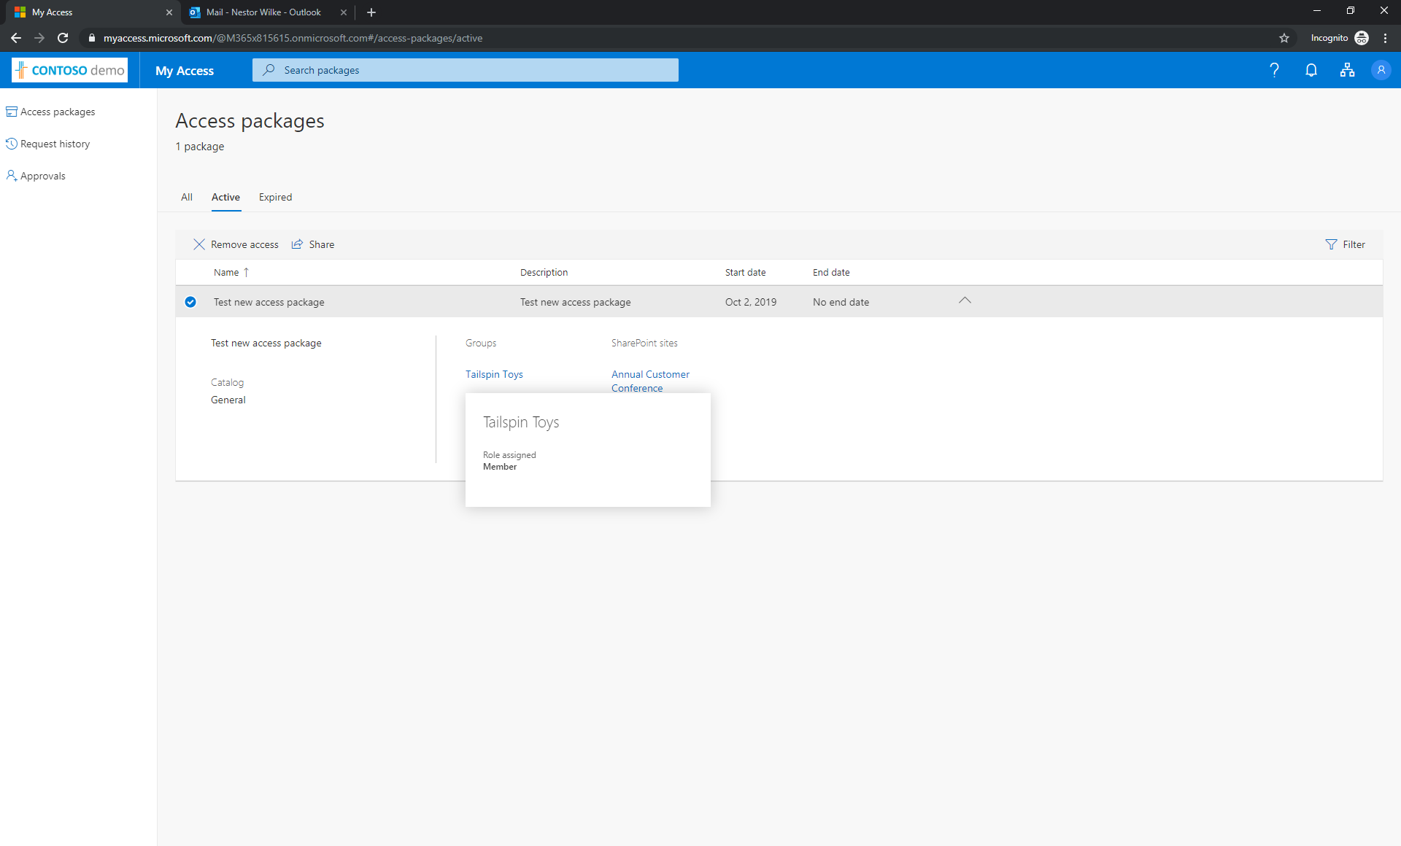

Slide 45
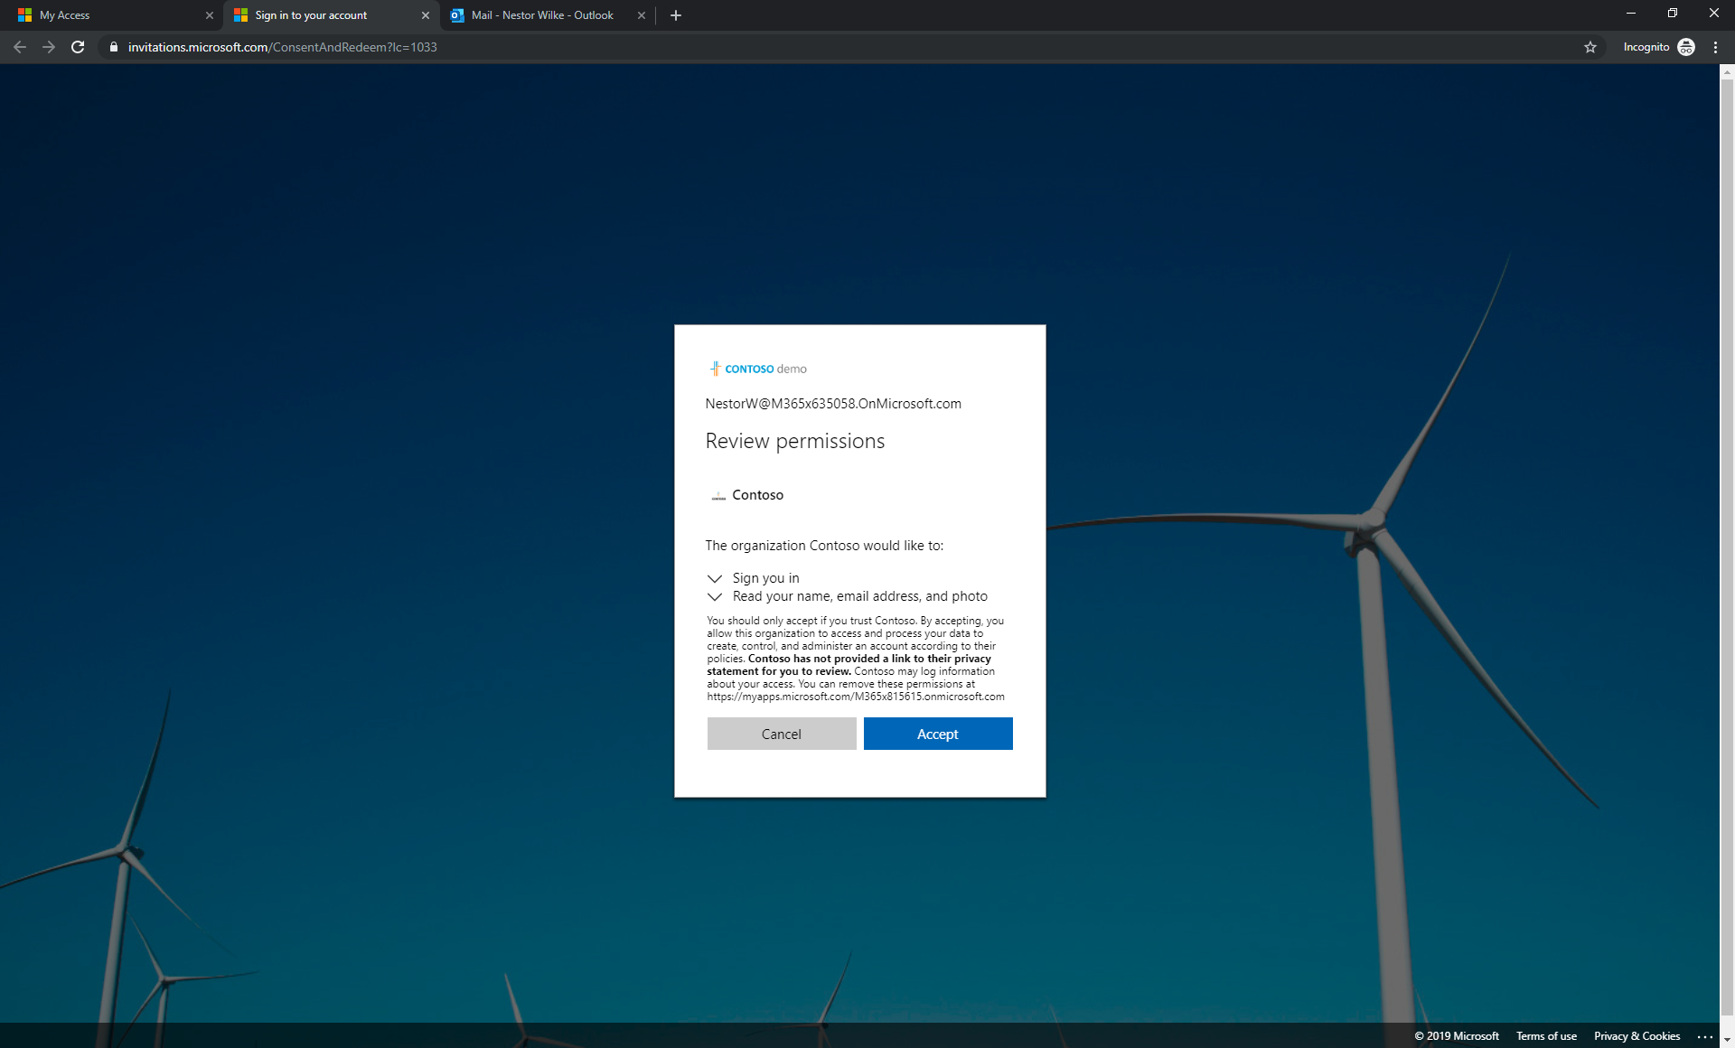

Slide 46
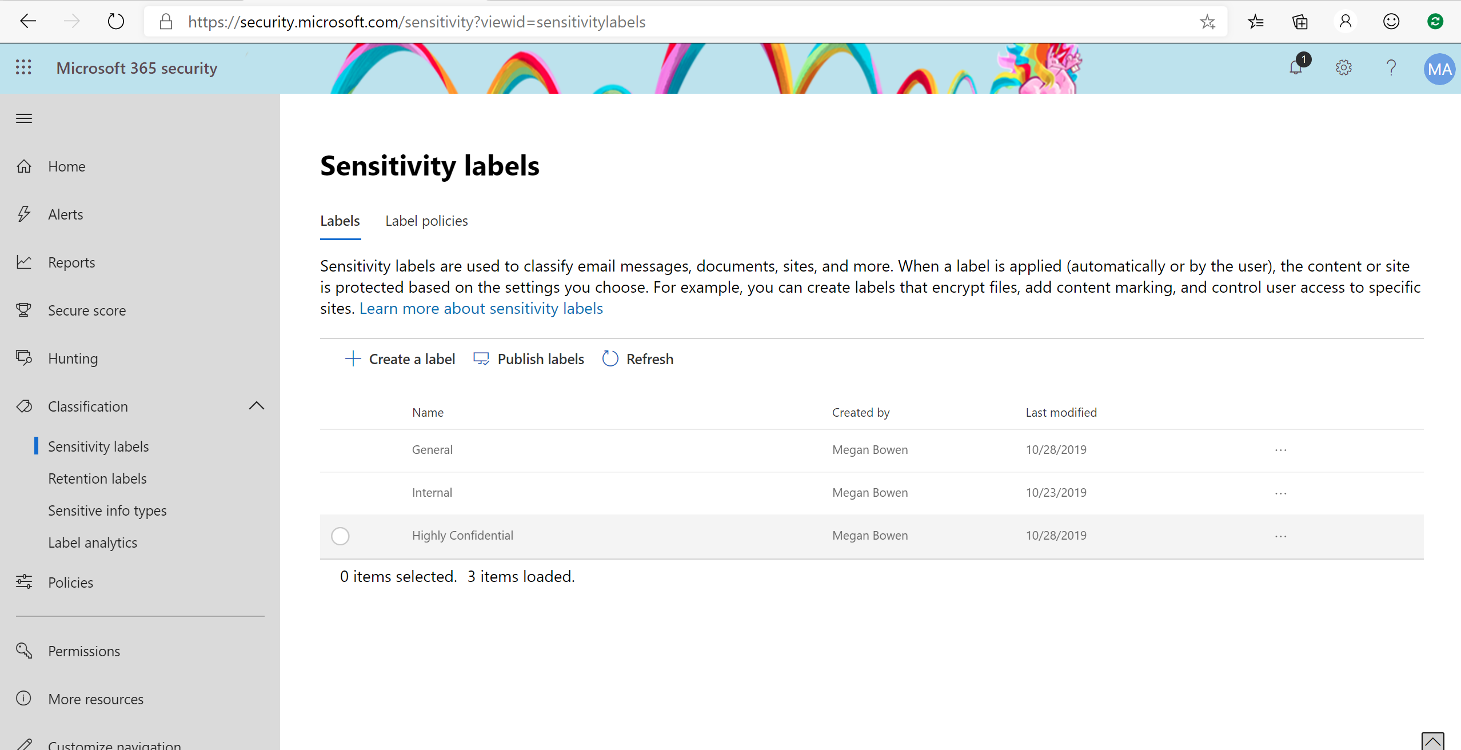

Slide 47
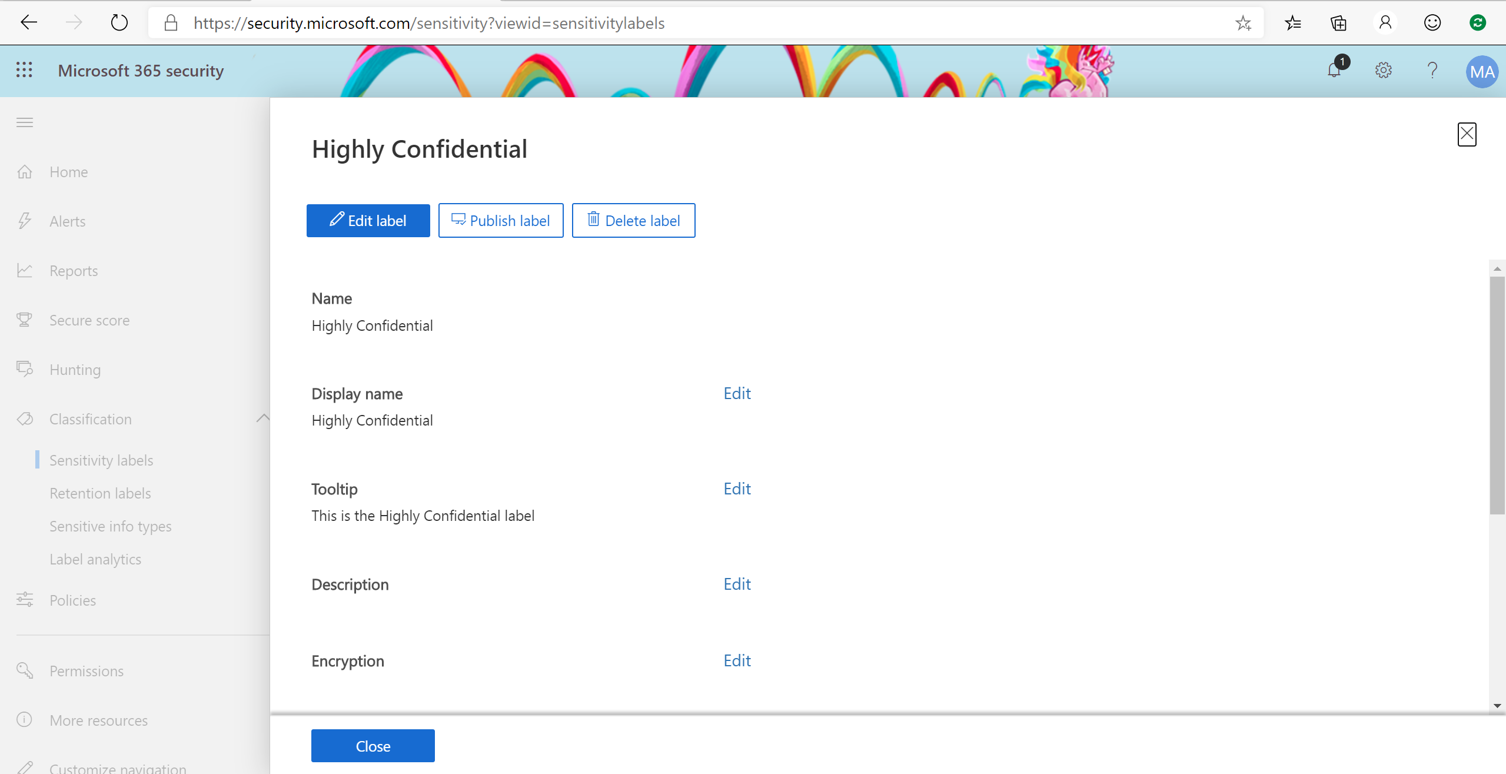

Slide 48
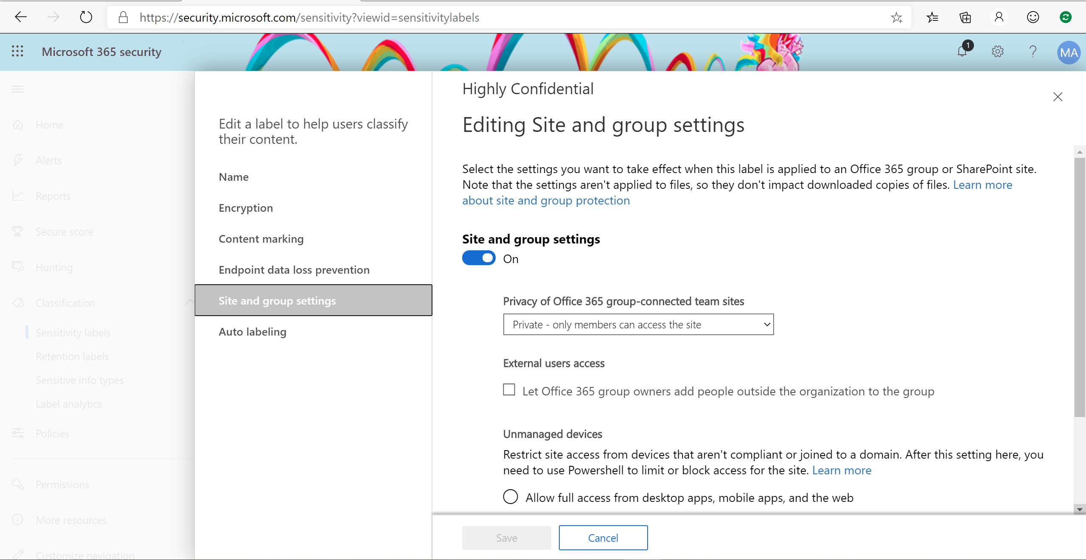

Slide 49
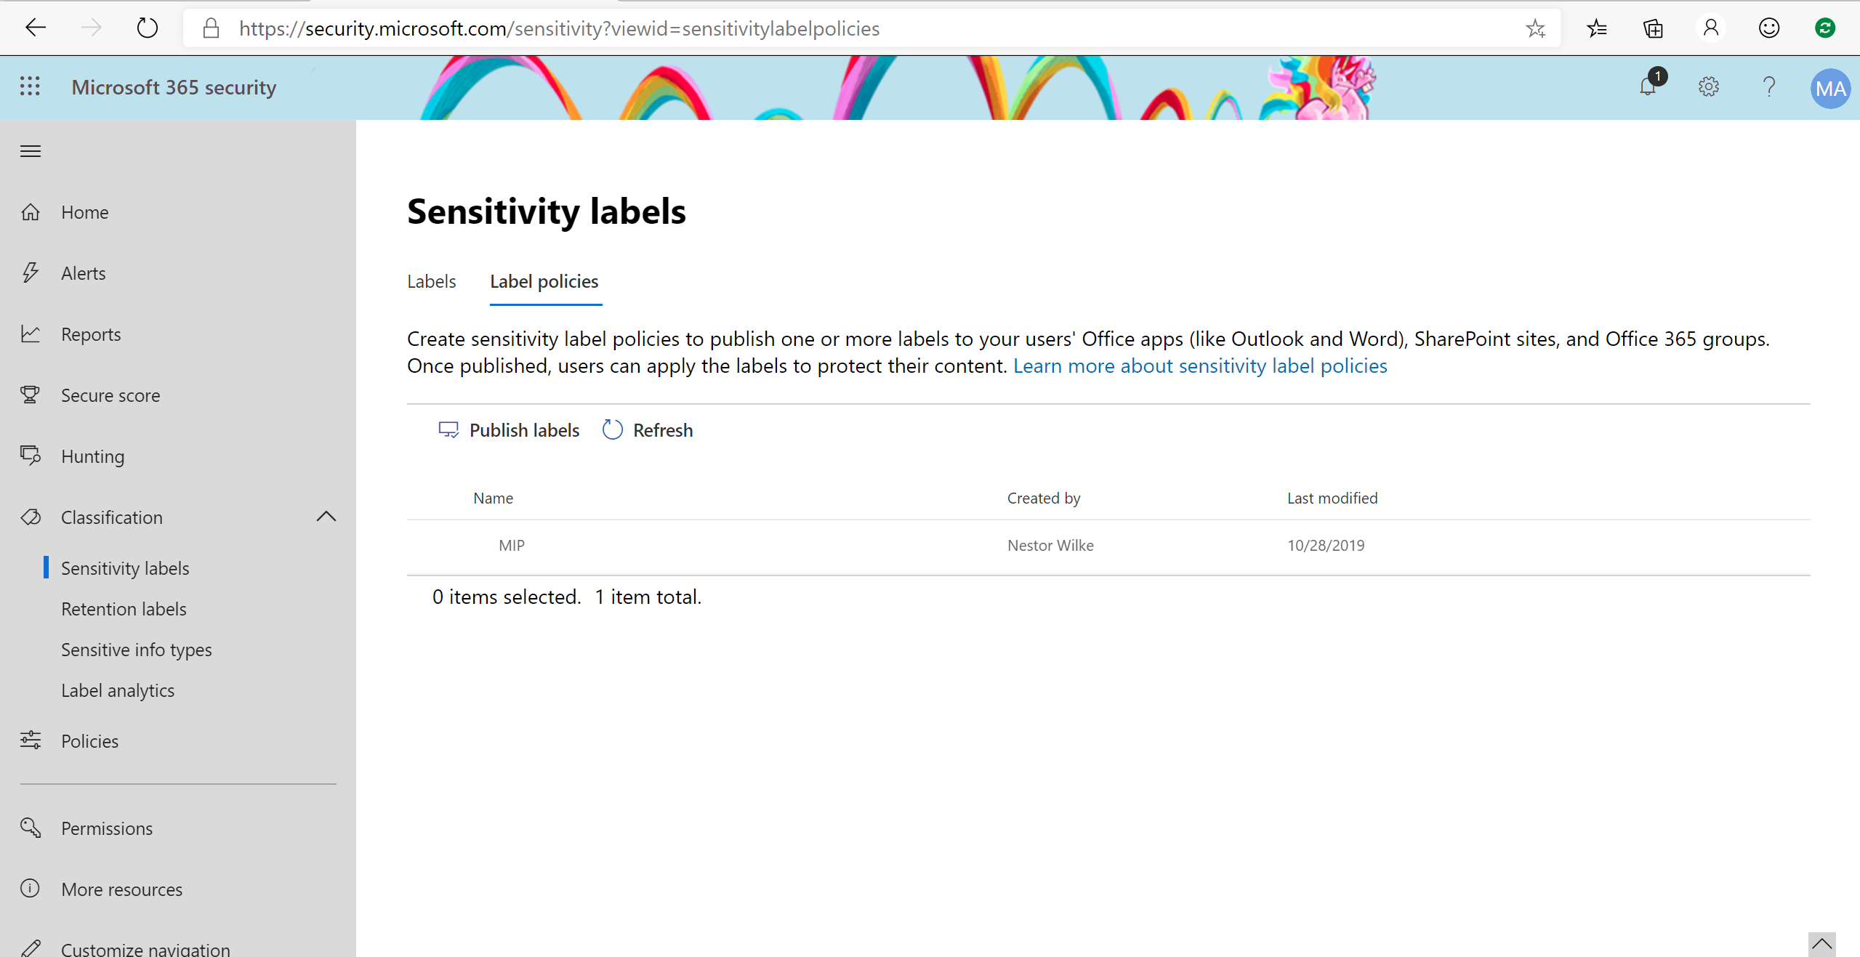

Slide 50
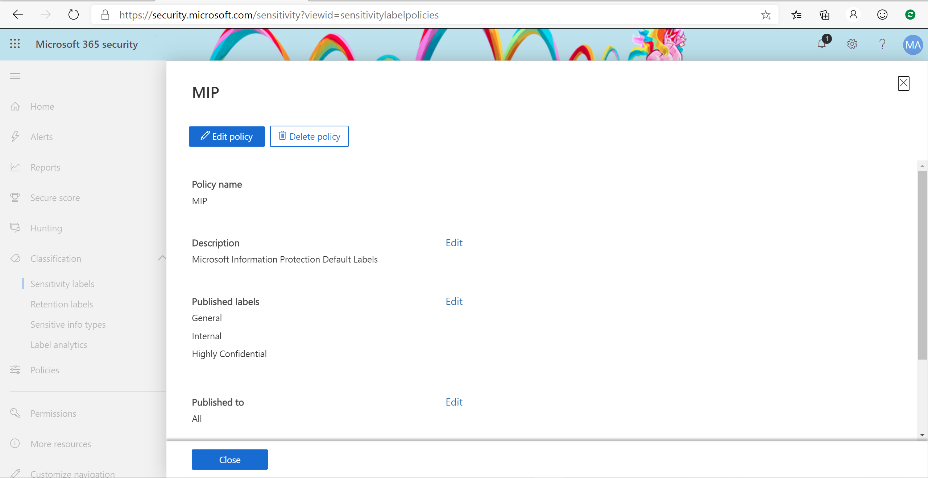

Slide 51
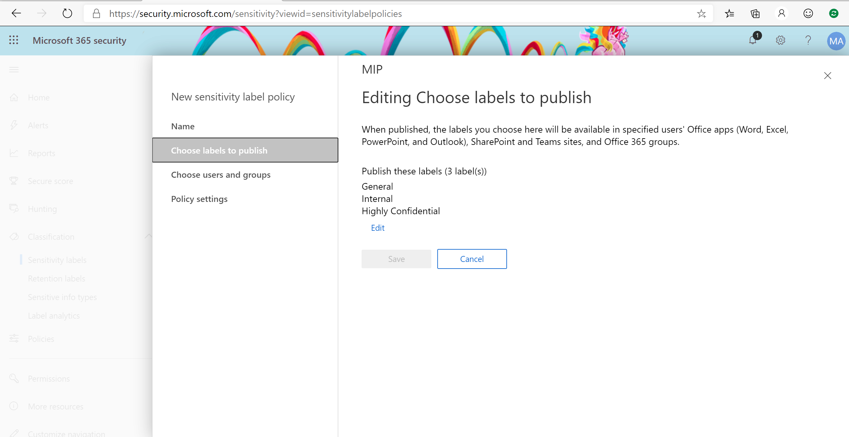

Slide 52
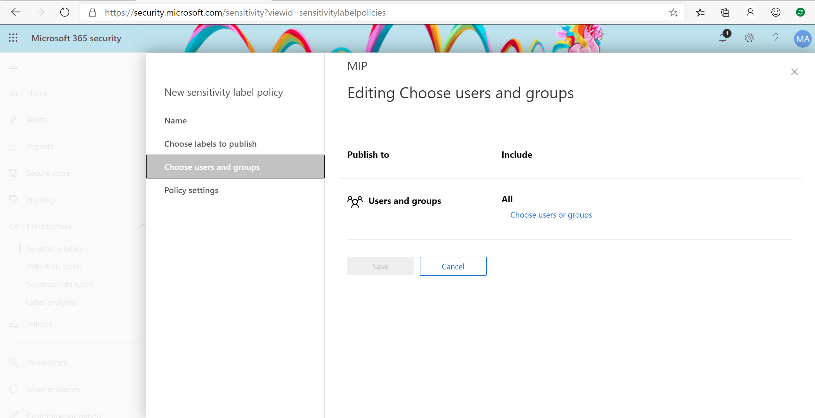

Slide 53
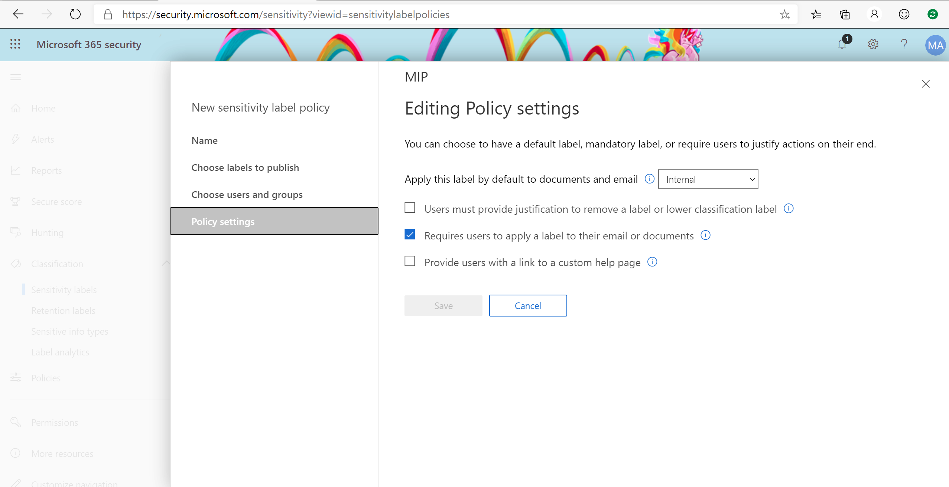

Slide 54
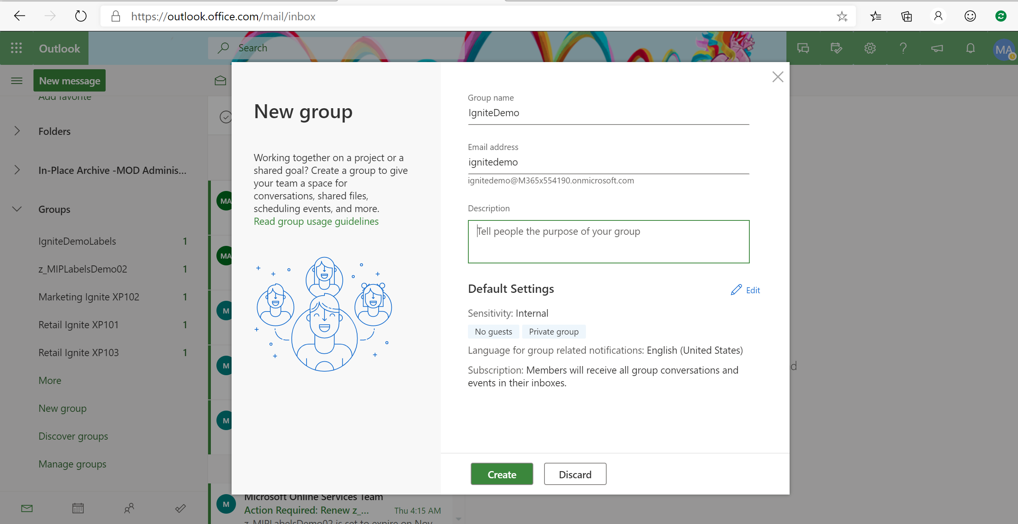

Slide 55
